Slide 1
Planning for opportunities along the St. Johns River: incorporating survey research and gis to support local decisions about water access facilities
Drs. Ashley Johnson and Ray Oldakowski
Department of Geography and the Environment
Jacksonville University
Association of American Geographers, Boston, April 27, 2017

Slide 2
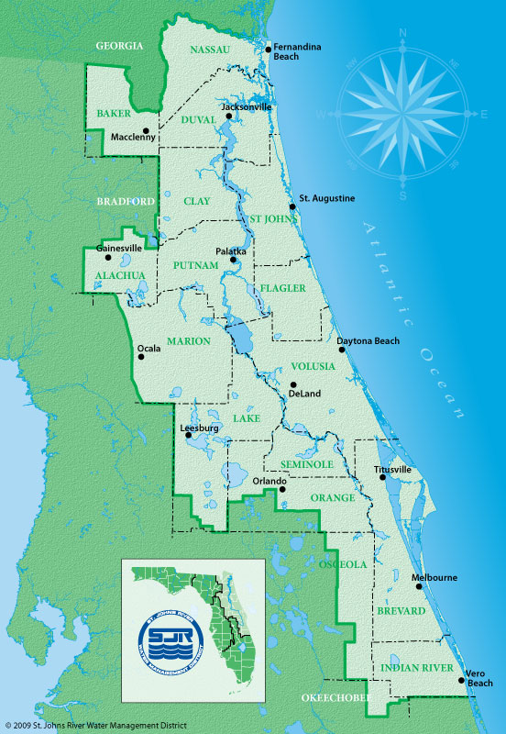
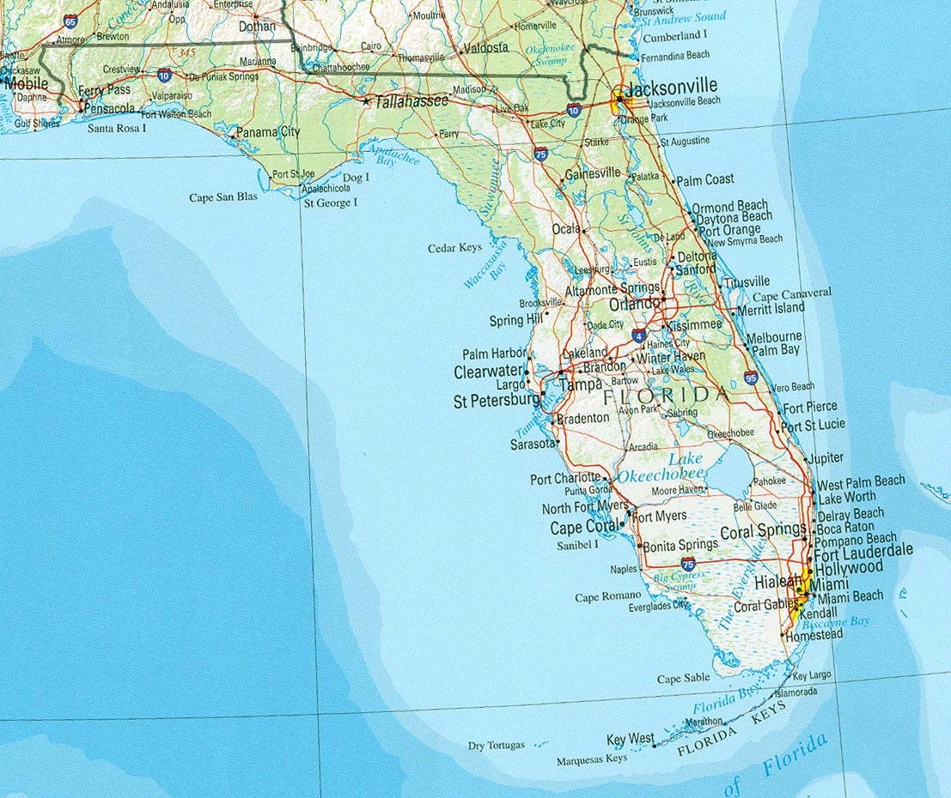

Slide 3
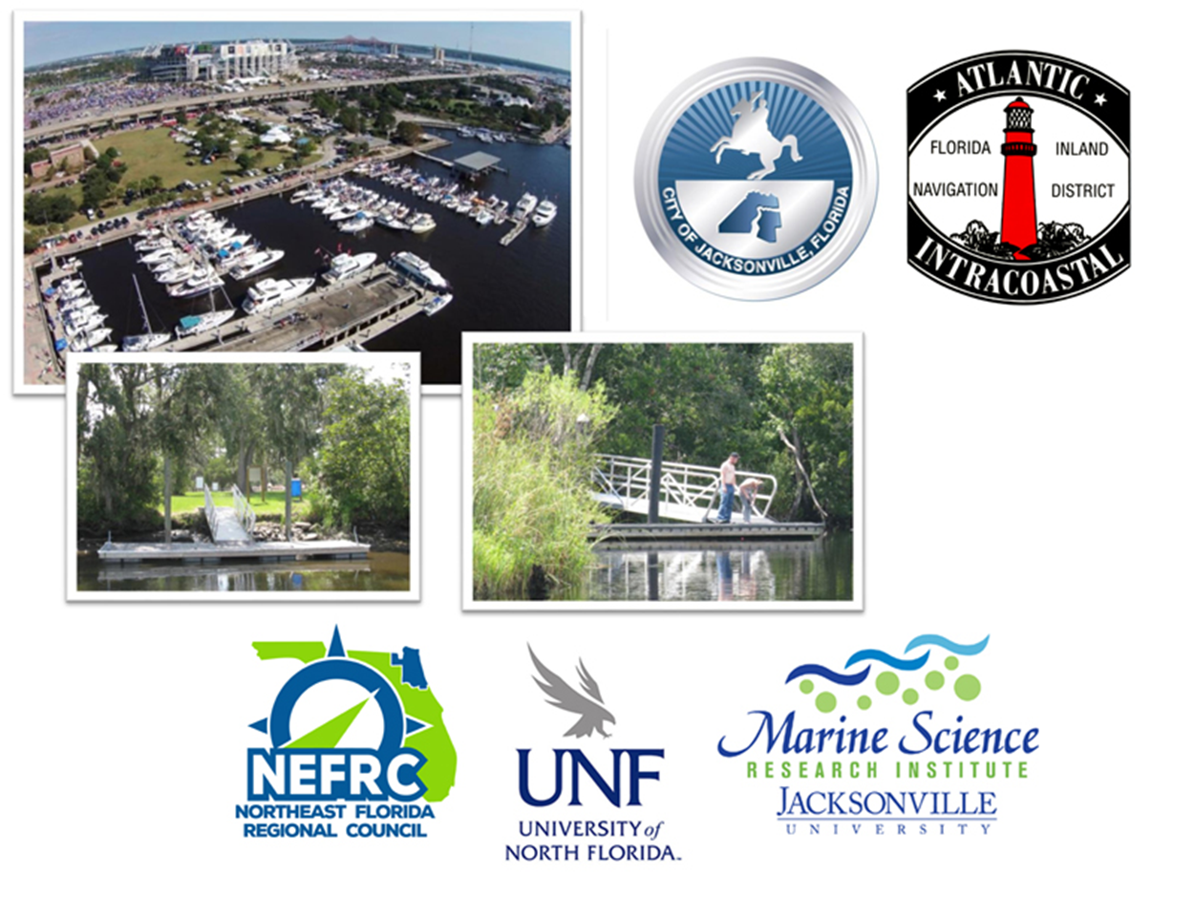
Duval County Maritime Management Plan

Slide 4
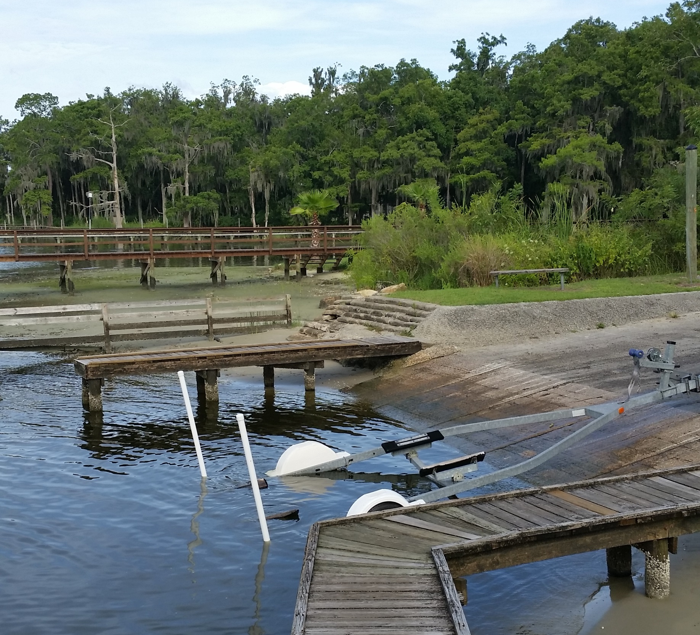
Duval County Maritime Management Plan
Goal 1: Identification of water access facilities that need maintenance and/or upgrades
Goal 2: Identification of additional water access facilities
Kayak launches
Working waterfront
Floating docks

Slide 5
GIS in the maritime environment
A marine GIS describes methods for the mapping and measurement of major ocean processes that affect the state of marine environment
managing spatial applications related to oceanographic and coastal problems
creating and producing geospatial data: coastal shorelines and bathymetry

Slide 6
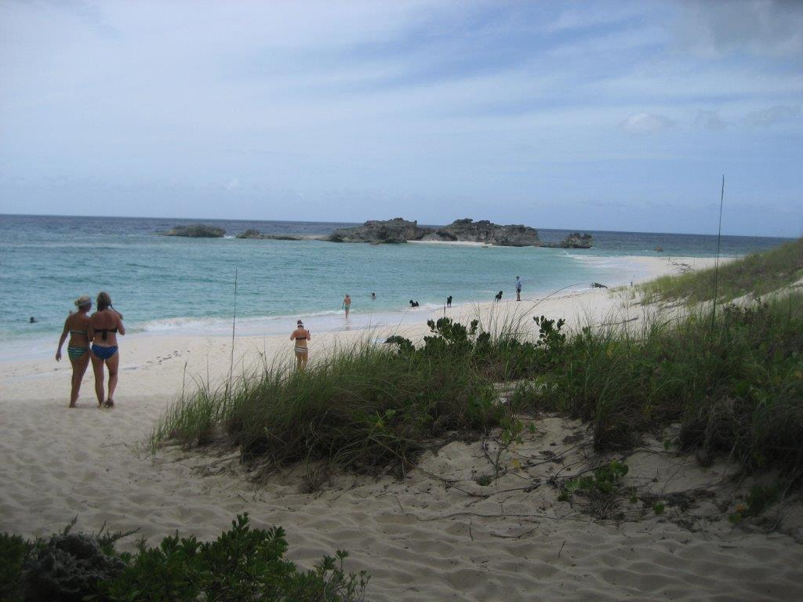
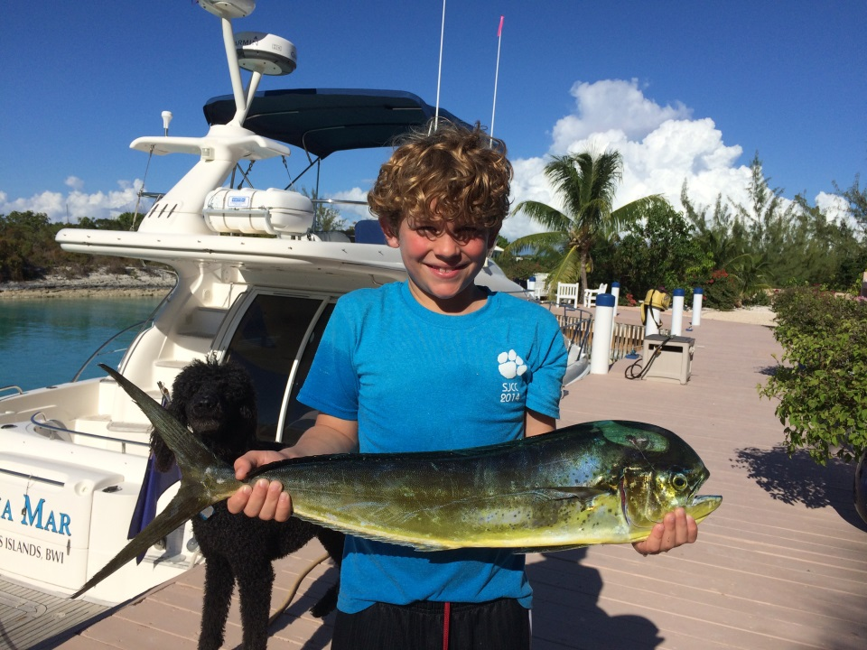
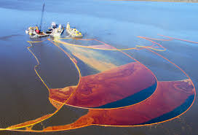
Examples of Marine & Coastal GIS
Coastal: captures activities and resources adjacent to terrestrial landscapes
Oceanographic: describes methods for the mapping and measurement of major ocean processes
Fisheries: provides a framework for the facilitation of the complex fisheries management process
Oil Spill Response

Slide 7
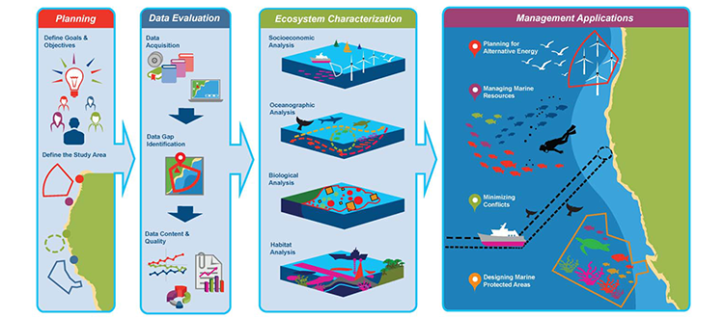
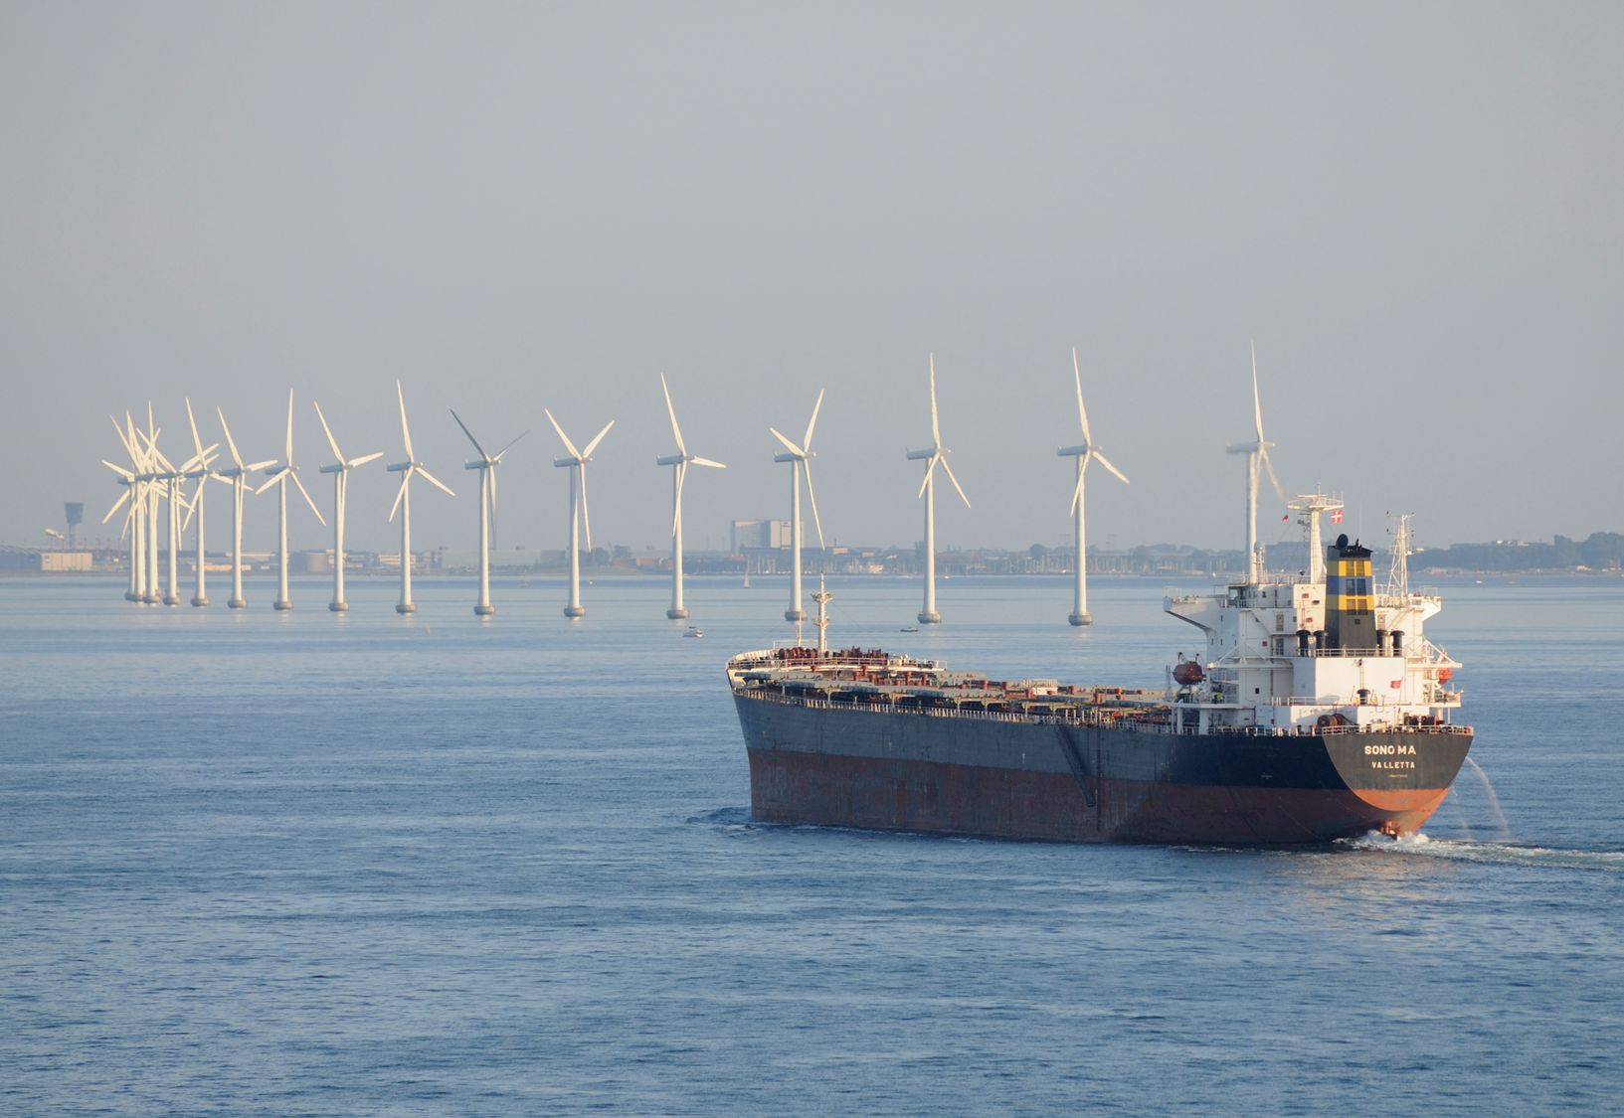
Marine & Coastal Spatial Planning
Did you know that the U.S. has a National Ocean Policy?
A science-based tool that can be used to address specific coastal and ocean management challenges to advance goals for economic development and conservation.

Slide 8
Public Input
Source: Ehler, Charles and Fanny Douvere (2009) Marine Spatial Planning: A Step by Step Approach Toward Ecosystem Based Management. Intergovernmental Oceanographic Commission and Man and the Biosphere Programme.

Slide 9
Duval County Maritime Management Plan
1. Story Map
2. Facilities App
3. Survey data and Spatial Analysis

Slide 10
MMP Survey Demographic Questions
9. What 2 streets intersect at the traffic light nearest to your house?
_____________________________________________________________
10. Which of the following categories best describes your 2014 total household income, before taxes:
Less than $50,000-----------------------------------1
$50,000-$100,000-----------------------------------2
More than $100,000--------------------------------3

Slide 11
Location of Survey Respondents

Slide 12
Surveys Questions on Assets, Location
On a scale from 1 to 10, where “1” not at all valuable and “10 is very valuable, please rate the value of each of the following assets to the Jacksonville community?
The St Johns River? 1 2 3 4 5 6 7 8 9 10
Navy Bases? 1 2 3 4 5 6 7 8 9 10
Jacksonville Jaguars? 1 2 3 4 5 6 7 8 9 10
What 2 streets intersect at the traffic light nearest to your house?

Slide 13
Correlations (Distance, River, Navy, Jags)
 | Distance (1.1) | River (9.7) | Navy (8.6) | Jags (6.8)
Distance | 1.0 .461
River | .419 .000 461 | 1.0 461
Navy | .080 .087 461 | .078 .096 461 | 1.0 461
Jags | .078 .096 461 | .027 .559 461 | .041 .293 461 | 1.0 461

Slide 14
Survey Questions on Additional Water Access Facilities

Slide 15
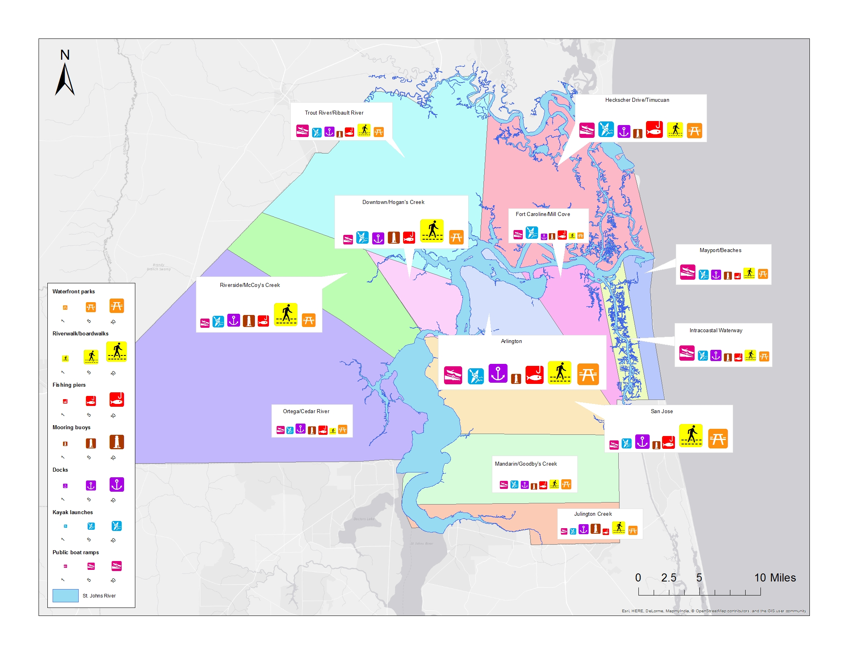

Slide 16
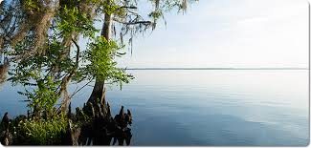
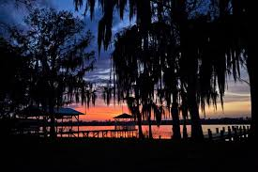
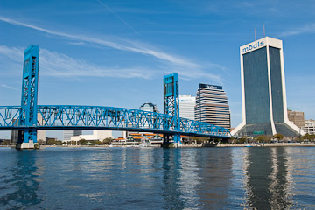
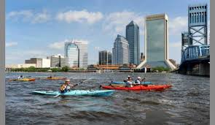
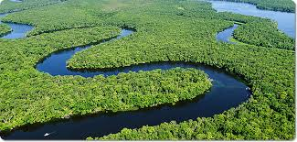
Questions?

