Slide 1
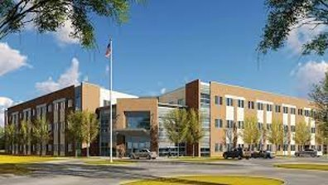
Clinical Mental Health Counseling
Practicum and Internship Directory ​2025-2026

Slide 2
About the Practicum and Internship Directory
The Practicum and Internship directory serves as a comprehensive resource for students and community stakeholders seeking information on the clinical affiliations available through the Jacksonville University CMHC program. Updated annually, the directory ensures that students and stakeholders have access to the latest information. If you are interested in becoming a clinical site, please reach out to the clinical directors for further details.

Slide 3
Overview of the Clinical Experience
Fall: Practicum Hours requirement 100 hours over 15 weeks (minimum 40 direct; 60 indirect) Approximately 12-15 hours on site per week ​
Spring: Internship 1 Hours requirement: 300 hours over 15 weeks (minimum 120 direct; 180 indirect) Approximately 22 hours on site per week ​
Summer: Internship 2 Hours requirement: 300 hours over 12 weeks (minimum 120 direct; 180 indirect) Approximately 20-22 hours on site per week ​
**Total over 3 semesters: 700 hours (minimum 280 direct & 420 indirect hours)**

Slide 4
Supervision Requirements
The site supervisor will be expected to provide at least one hour of individual supervision a week, throughout the clinical experience.
Students may participate in group supervision with 3 or more interns.
Students are expected to participate in weekly 3-hour group supervision through the practicum and internship courses.

Slide 5
Site Supervisor Requirements
The supervisor must meet the requirements per 2016 CACREP Standards (Section 3: Professional Practice-Supervisor Qualifications P & Q) “Site supervisors have:
(1) a minimum of a master’s degree, preferably in counseling, or a related profession;
(2) relevant certifications and/or licenses;
(3) a minimum of two years of pertinent professional experience in the specialty area in which the student is enrolled;
(4) knowledge of the program’s expectations, requirements, and evaluation procedures for students; and
(5) relevant training in counseling supervision.

Slide 6
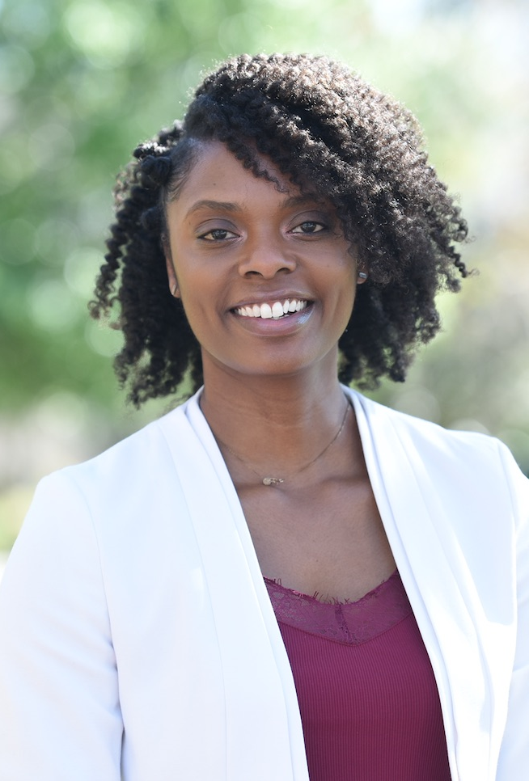
Dr. Michelle Ellis ​
Associate Professor &​ Clinical Director (Jacksonville)
Dr. Ellis serves as the clinical director for the JU CMHC program, overseeing all clinical-related tasks at the Jacksonville campus.
Email: mmitche40@ju.edu

Slide 7

Dr. Seneka Gainer
Assistant Professor & Clinical Director (Palm Coast)
Dr. Gainer serves as the clinical director for the JU CMHC program, overseeing all clinical-related tasks at the Palm Coast campus.
Email: sarring@ju.edu

Slide 8

Aging True
https://agingtrue.org/

Slide 9

Agape Family Health
https://www.agapefamilyhealth.org/

Slide 10

AMiKids Behavioral Health
https://amikids.org/location/amikids-jacksonville/

Slide 11

Aspire Health Partners
https://aspirehealthpartners.com/

Slide 12

Baker County School District
https://www.bakerk12.org/

Slide 13

Baptist Behavioral Health
https://www.baptistjax.com/doctors/baptist-behavioral-health

Slide 14

Beacon Pediatrics
https://www.beaconpediatric.com/

Slide 15

Beyond Counseling
https://beyondcounseling.me/

Slide 16

Children’s Home Society
https://chsfl.org/

Slide 17

Child Guidance Center
https://cgcjax.org/

Slide 18

Daniel Kids
https://www.danielkids.org/

Slide 19
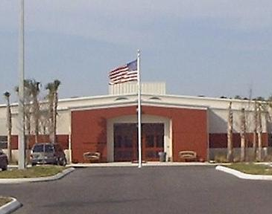
Deep Creek Youth Academy
https://www.djj.state.fl.us/programs-facilities/residential-facilities/deep-creek-youth-academy

Slide 20

Devereux Advanced Behavioral Health
https://www.devereux.org/

Slide 21

Delores Barr Weaver Policy Center
https://www.seethegirl.org/

Slide 22

Dupont Counseling Group (Jewish Family Services)
https://jacksonvillecounseling.org/

Slide 23

Elite DNA Behavioral Health
https://elitedna.com/

Slide 24

EMBRACE Jax
https://www.embracejax.org/

Slide 25

Episcopal Children’s Services
https://www.ecs4kids.org/

Slide 26

Epic Behavioral Healthcare
https://www.epicbh.org/

Slide 27

Family Foundations of Northeast Florida
https://familyfoundations.org/

Slide 28

Family Life Center
https://flcfv.org/

Slide 29

Flagler Cares
https://www.flaglercares.org/

Slide 30

Flagler College Counseling Center
https://www.flagler.edu/student-life/health-wellness/counseling-services

Slide 31

Flagler Schools
https://www.flaglerschools.com/

Slide 32

Florida Psychological Associates
http://www.floridapsy.com/

Slide 33

Golden Victory Medical-Ponte Vedra
https://goldenvictorymedical.com/

Slide 34

Halifax Health
https://halifaxhealth.org/

Slide 35

Jax BCH Counseling
https://jaxbchcounseling.com/

Slide 36

JU Men’s Clinic
https://www.ju.edu/mentalhealth/mens-mental-wellness-clinic.php

Slide 37
JU Student Counseling Center
https://www.ju.edu/counseling/

Slide 38

Keep Evolving Beyond Therapy (KEBT)
https://kebtjax.com/

Slide 39

Lakeview Health
https://www.lakeviewhealth.com/

Slide 40

Lifestyle Management Counseling
https://www.lifestylemanagementcounseling.com/

Slide 41

Mandala Family Wellness
https://mandalawellness.com/

Slide 42

Memorial Behavioral Health Center
https://memorial.health/memorial-behavioral-health-center-in-jacksonville/overview/

Slide 43

New Perspectives Therapeutic Services
https://newperspectivestherapeuticservices.com/

Slide 44

Positive Development, LLC
https://www.positivedevelopmentllc.com/

Slide 45


Putnam County Schools
https://www.putnamschools.org/

Slide 46

Rivers Edge Counseling Center
https://www.riversedgeorangepark.co/

Slide 47

River Point Behavioral Health
https://www.riverpointbehavioral.com/

Slide 48

St. Augustine Counseling
https://staugustinecounseling.com/

Slide 49

Steven A. Cohen Military Family Clinic at Centerstone
https://centerstone.org/cohen-military-family-clinic/jacksonville/

Slide 50

Starting Point Behavioral Healthcare
https://www.spbh.org/

Slide 51

Therapeutic Hope Counseling, LLC
https://www.therapeutichopecounseling.com/

Slide 52

Thunderbolt Counseling
https://thunderboltcounseling.com/

Slide 53

Transformative Growth Counseling
https://transformativegrowth.org/

Slide 54

The Arc Jacksonville
https://arcjacksonville.org/

Slide 55

The Arc of the St. Johns
https://www.arcsj.org/

Slide 56

The House Next Door
https://www.thehnd.com/

Slide 57

The Grow Group
https://thegrowgroup.org/

Slide 58

UNF Counseling Center
https://www.unf.edu/brooks/counseling-center/

Slide 59

Women’s Center of Jacksonville
https://thewcj.org/

Slide 60

Wekiva Springs Center
https://wekivacenter.com/

Slide 61

Ascension St. Vincent's Family Medical Center
https://healthcare.ascension.org/

Slide 62

SMA Healthcare
https://smahealthcare.org/

Slide 63

Sophros Recovery
https://www.sophrosrecovery.com/

Slide 64

Turning Tides Eating Disorder Treatment Center
https://www.turningtidesed.com/

Slide 65

Willow Tree Therapy Services, LLC
https://willowtreetherapyservices.org/

Slide 66

St. Augustine Counseling
https://staugustinecounseling.com/

Slide 67

Residing Hope
https://residinghope.org/

Slide 68
JU CMHC HANDBOOKS
https://www.ju.edu/mentalhealth/current/CMHCStudentProgramHandbook25-26.pdf
https://www.ju.edu/mentalhealth/current/JU_PI_Student_HANDBOOK_25-26.pdf
https://www.ju.edu/mentalhealth/current/JU_SITE_SUPERVISOR_HANDBOOK_25-26.pdf

