Slide 1



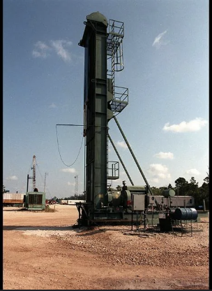
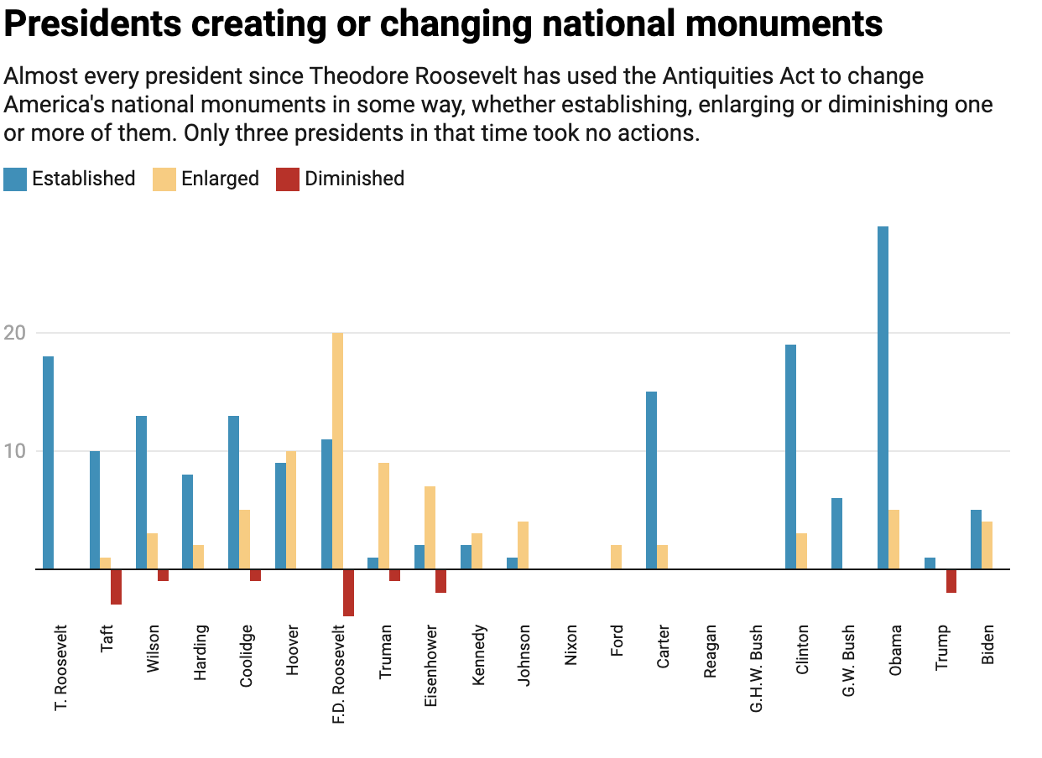
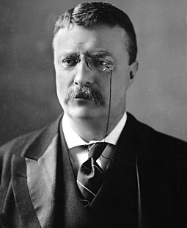
Federal Lands, Natural Resources, and the President’s Power in Affecting Land Conservation Efforts
Nathan Michael Summers
Faculty Advisor: Professor Shelley Grant,
Jacksonville University, History Department
Significance
The Evolution of Land Conservation in the 20th Century
Findings
Land conservation has been a priority in the United States since the start of the 20th century. However, the increase of federal lands has also been met with a push from drilling/mining companies who wish to use federal lands for their resources. Land conservation will become harder if the President chooses to loosen up protection of federal lands in favor of economic interests.
March 3, 1849- Congress passed 9 Stat 395, creating the Department of the Interior for the management of all U.S. Territories, federal lands, and natural resources. (Act of 1849, 9 Stat. 395)
1906- The Antiquities Act was passed, giving the Executive Branch more responsibility over creating and managing federal lands. Act put all submerged lands lying seaward of state coastal waters under U.S. jurisdiction and authorized mineral exploration in those regions. (Act of 1906, 34 Stat. 225)
1920- The Mineral Leasing Act allowed for the creation of a leasing system for oil and gas contractors to produce fossil fuels off of federal land. (Act of 1920, 41 Stat. 437)
1953- The Outer Continental Shelf Lands Act put all submerged lands lying seaward of state coastal waters under U.S. jurisdiction and authorized mineral exploration in those regions. (boem.gov)
2017- The Trump Administration cut 1.9 million acres of federal land in Utah, raising the debate of the President’s power over creating and destroying federal land status (Britton-Prudy, 2018)
Throughout the 20th Century, the Executive Branch has both expanded and cut back on the size of federal lands , citing a broad interpretation of the Antiquities Act. This chart from the Congressional Research Service shows the diminishing of lands has happened before and even recently, despite Biden restoring those lands.
Figure 3- Congressional Research Service
The Wicked Problem
The Trump Administration in 2017 proposed the largest rollback of federal land status in American history. While the issue is still being debated, the problem is clear. Can the President remove federal land that was previously created? If the answer is yes, then land conservation efforts won’t have any recourse if a future President decides to side with extractive industries..
. .
Potential Solutions
Moving away from fossil fuels and gases towards renewable energy
A shift towards allowing land reductions to be carried out by state representatives in Congress rather than the President, who can use the Antiquities Act to avoid Environmental impact reports (Vincent, 2024).
Figure 1- Miami Herald
Mining and Drilling on Federal Lands
The Antiquities
Act of 1906
Figure 2- PBS
The Department of the Interior has the power to offer leasing of federal land for mining and drilling. However, these actions lead to air pollution, destruction of ecosystems, and the potential for oil spills (Loris, 2021). Since the President’s role in protecting federal land has increased over time, the possibility for the President to ignore the desire for conservation in favor of allowing companies to strip the environment for resources is strong enough to be a cause for concern.
References
Gave the President the authority to establish national monuments on existing federal land. Presidents have used this Act almost 300 times to set aside new federal lands for protection (nps.gov).
U.S. Congress. Antiquities Act. 1906. 34 Stat. 225
U.S. Congress. Statutes at Large. 1849. 9 Stat 395
U.S. Congress, Mineral Leasing Act. 1920. 41 Stat. 437
Vincent, Carol. National Monuments and the Antiquities Act. May 10, 2024. Report 41330 from the Congressional Research Service.
Loris, Nick. 2021. What More Public Lands Leasing Means for Achieving U.S. Climate Targets. Written testimony from C3 Solutions
Antiquities Act of 1906. National Park Service web. Last updated on February 10, 2025.
Britton-Prudy, Jedediah. 2018. Whose Lands? Which Public? The Shape of Public-Lands Law and Trump’s National Monument Proclamations. Vol 45:921 published in Ecology Law Quarterly.
OCS Lands Act History. Official Department of the Interior Web.

Slide 2
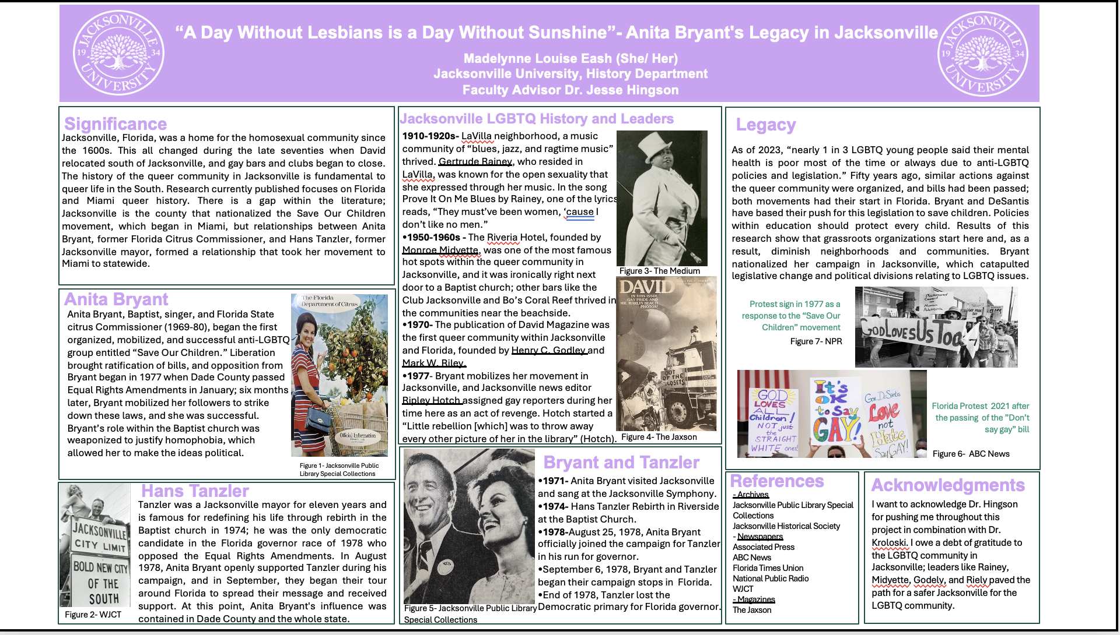

Slide 3
Poster Helpful Links
https://ur.umbc.edu/poster-presentation-examples/
https://www.posterpresentations.com/free-poster-templates.html

