Slide 1



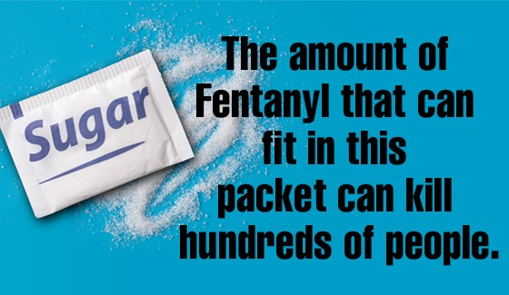
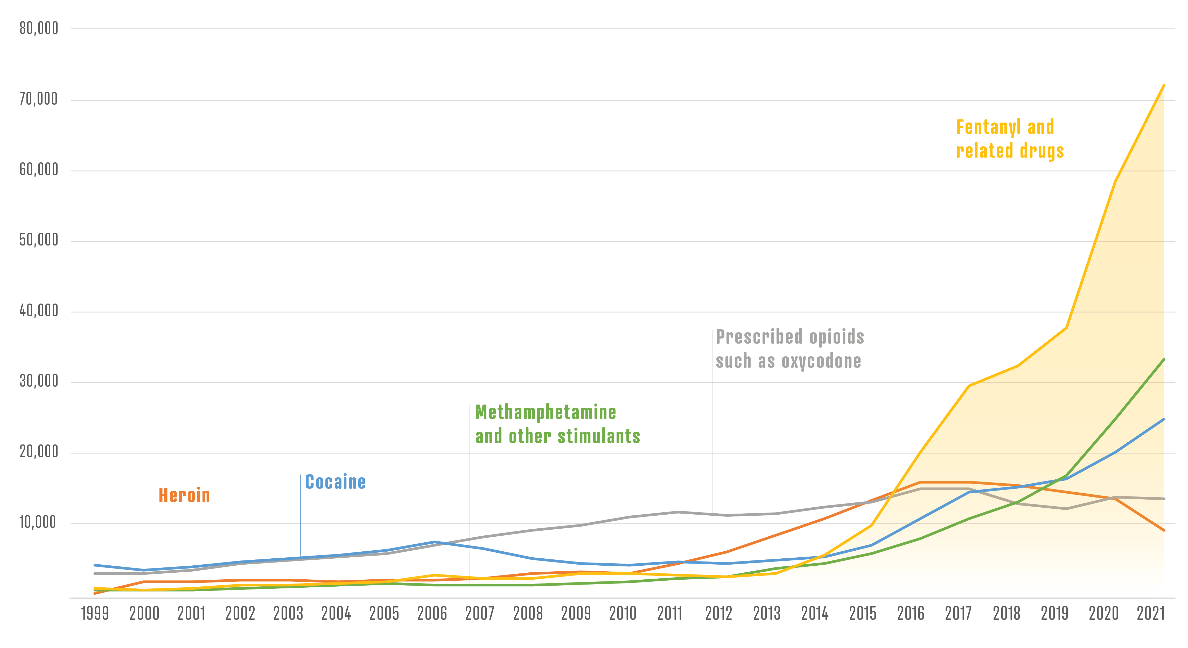
Fentanyl: A Silent Killer - Recognize, Prevent and Protect
Paul Reidy
Faculty Sponsor: Professor Shelley Grant
Jacksonville University, Jacksonville, FL, USA
Background
Conclusion
Fentanyl was initially prescribed as a pain killer and is “100 times more potent than morphine” (Fentanyl, n.d.). The drug is still legal and approved by the Food and Drug Administration. Fentanyl is being produced by cartels in Mexico, and this is when it becomes illegal. The drug is commonly laced in other drugs like Marijuana and Cocaine.
Drug users avoid interactions with the police due to stigma surrounding the illegal use of fentanyl. Implementing police training could help reduce the reaction police have to these individuals. Officer participation in providing test strips and encouraging the use of harm reduction sites would be beneficial in strengthening the relationship between those using the drug and those enforcing the law.
Drug Free NJ - Home. (n.d.). https://www.drugfreenj.org/
Harm Reduction Initiatives
Compared to other countries the United States Fentanyl overdose rate is alarmingly high. “Other countries, including European countries and Canada, have invested more in harm reduction strategies than the U.S” allowing them to slow the spread (Yeo et al.,2022). They implemented injection sites and medication-assisted treatment areas.
Overview
Recommendations
Fentanyl is killing 200 people a day, and “a sugar packet, has the potential to kill up to 500 people” (Overdose Deaths Decline, Fentanyl Threat Looms, 2024). While the lethality of the drug is known, the use continues to rise. Drug users fear being caught by the police, so they seclude themselves to use. If they are to overdose, they are to far away for the police to save them in time. Police also have a stigma toward overdoses and drug use that can cause a divide. The government continues to spend its money in the wrong areas to stop the use of Fentanyl.
The most effective way to stop the spread is through harm reduction, Police training and test strips. We need to help the people not fight the cartels
Police Training
Officers who have been on the job for years tend to have the view that they are being forced to wear different hats. That being law enforcement and medical personal. The officers who had a more positive view on administering Narcan where ones who had a “connection to someone who uses drugs and/or due to a background in emergency medical services” (Lloyd et al., 2023.) Research has shown that specific training related to interacting with drug users show officers have a more positive opinion about them.
References
Fentanyl. (n.d.). DEA. https://www.dea.gov/factsheets/fentanyl
Lloyd, D., Rowe, K., Leung, S.-Y. J., Pourtaher, E., & Gelberg, K. (2023). “It’s just another tool on my toolbelt”: New York state law enforcement officer experiences administering naloxone. Harm Reduction Journal, 20(1), 1–10. https://doi.org/10.1186/s12954-023-00748-3
Overdose deaths decline, fentanyl threat looms. (2024, December 16). DEA. https://www.dea.gov/press-releases/2024/12/16/overdose-deaths-decline-fentanyl-threat-looms#:~:text=More%20than%20107%2C000%20people%20lost,to%20opioids%20such%20as%20fentanyl.
Reed, M. K., Siegler, A., Esteves Camacho, T., London, K., Schaeffer, K., & Rising, K. L. (2024). Making Harm Reduction More Accessible: Fentanyl Test Strip Awareness and Attitudes among Emergency Department Patients Who Use Drugs. Substance Use & Misuse, 59(3), 398–404. https://doi.org/10.1080/10826084.2023.2275561
Winograd, R. P., Stringfellow, E. J., Phillips, S. K., & Wood, C. A. (2020). Some law enforcement officers’ negative attitudes toward overdose victims are exacerbated following overdose education training. American Journal of Drug & Alcohol Abuse, 46(5), 577–588. https://doi.org/10.1080/00952990.2020.1793159
Yeo, Y., Johnson, R., & Heng, C. (2022). The Public Health Approach to the Worsening Opioid Crisis in the United States Calls for Harm Reduction Strategies to Mitigate the Harm From Opioid Addiction and Overdose Deaths. Military Medicine, 9/10, 244–247. https://doi.org/10.1093/milmed/usab485
Overdose Deaths From 1999-2021
Fentanyl Test Strips
Fentanyl Test strips are used to test street drugs for Fentanyl. “All [drug users] accepted training and test strips…few were somewhat or very concerned about having [test strips] if stopped by police” (Reed et al., 2023).
Hayes. (n.d.). Drug overdose deaths chart. NIST. https://www.nist.gov/image/drug-overdose-deaths-chart-0

