Slide 1
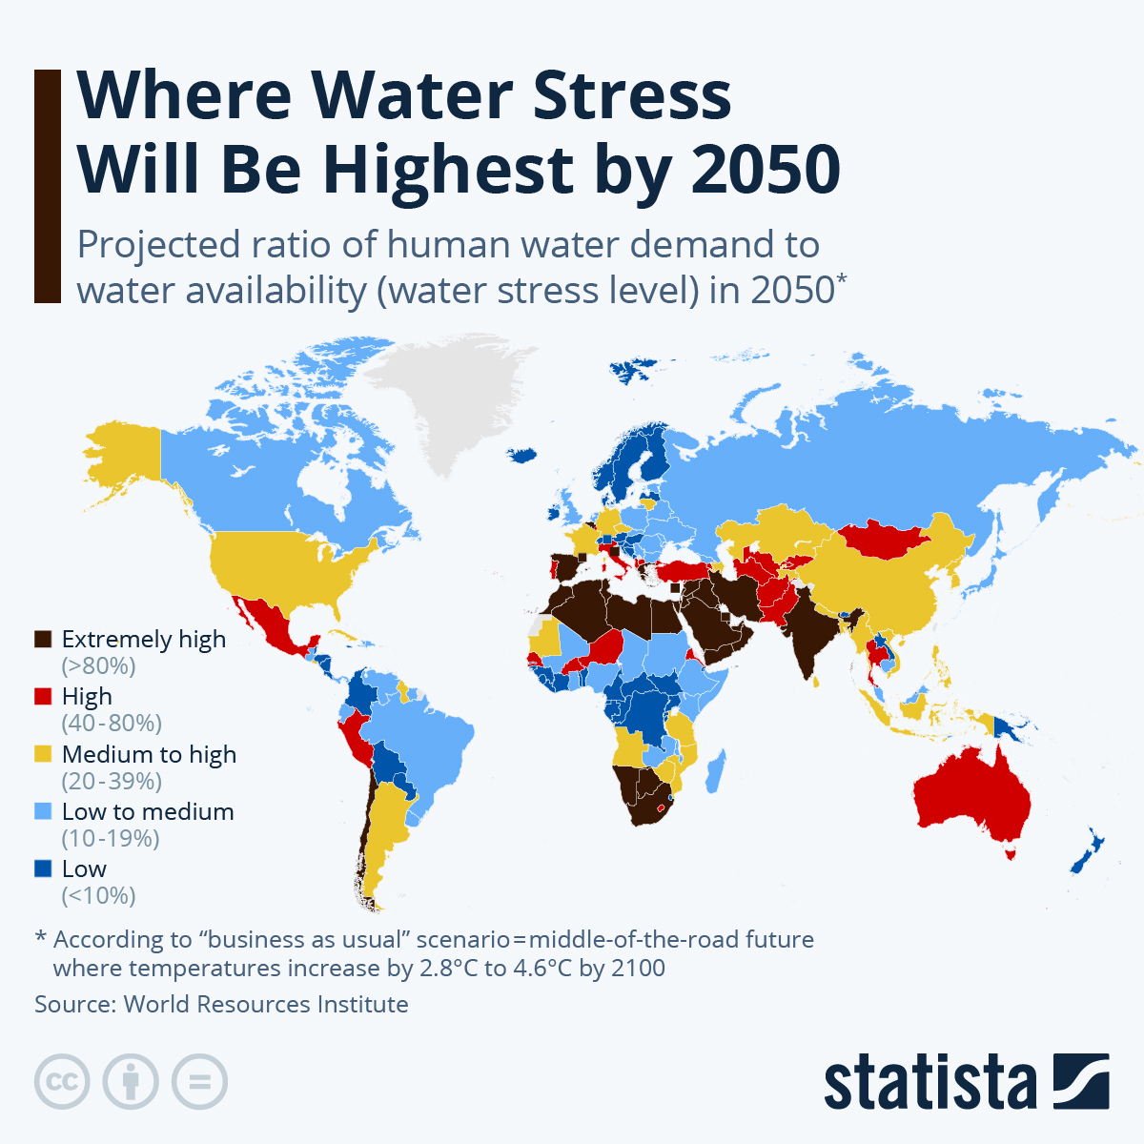
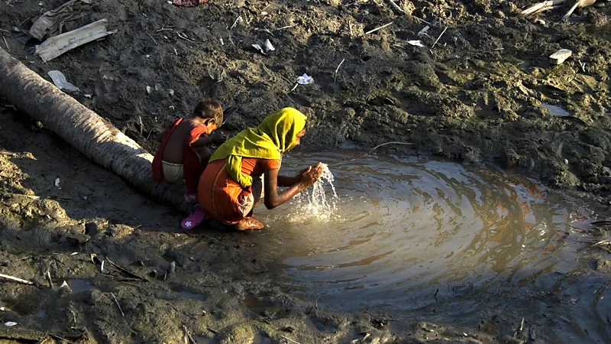
Tackling Freshwater Shortages and Pollution: A Call for Global Action for Fresh Water Security
Luke Telford Manges
Faculty Sponsor: Professor Shelley Grant
Jacksonville University, Jacksonville, FL, USA
Significance
Findings
Solutions
Ongoing freshwater shortages will have severe global consequences, particularly in developing regions, where access to clean water is already limited. Rising demand, climate change, and inadequate resource management are accelerating the crisis, making it essential to implement effective solutions. Addressing water scarcity and pollution requires coordinated international efforts and advancements in technology, including desalination, cloud seeding, and improved water collection systems for residential areas.
Many regions, especially in developing countries, are experiencing severe freshwater shortages.
Without intervention, famine and loss of life will become a global issue.
Industrial waste, agricultural runoff, and inadequate infrastructures are causing pollution and waste of freshwater.
Smallholder farmers are highly vulnerable to water scarcity, with access to irrigation infrastructure and natural water sources playing a key role in their ability to adapt (Aguilar et al. p.1).
Water pollution in developing countries is worsened by poor regulatory structures and improper waste disposal, making vital water sources unsafe for consumption (Nimusiima et al. p.1).
The global demand for water is projected to increase by 20–30% by 2050, with industrial water usage expected to rise significantly, contributing to water scarcity concerns (Weerasooriya et al. p.2).
Water scarcity and pollution threaten agricultural yields, leading to food insecurity and malnutrition, particularly in developing nations (Weerasooriya et al. p.7).
Cloud seeding- is a weather modification technique used to encourage the formation of precipitation. By introducing substances like silver iodide or salt particles into the atmosphere, typically into clouds increasing the likelihood of rainfall.
Installation of a more advanced water collection system for communities.
Desalination-Converting seawater into fresh water is a promising method to meet freshwater demands. Improvements in desalination efficiency and reduction in cost and energy usage are crucial.
All first world nations should be working together to help produce a solution to this dire crisis that will impact the world soon. They have the resources to help produce a solution to help those in need especially in developing countries.
Objective
To inform audiences about the global impact of freshwater shortages and pollution, highlighting key causes, consequences, potential solutions, and to promote awareness.
Analyze the role of engineering advancements in helping water scarcity and pollution, showcasing technologies like desalination, cloud seeding, and advanced water collection systems.
Explore government and corporate responsibilities in combating water crises through improved regulations, infrastructure investment, and pollution control measures.
Conclusion
Water Stress level by 2050
Water scarcity and pollution threaten global food security, health, and economic stability. An increasing demand, climate change, and poor resource management worsen the crisis. Sustainable solutions, such as improved water conservation and stronger regulations, are essential to ensuring access to water.
The map illustrates projected global water stress levels by 2050, highlighting regions expected to experience extreme shortages due to rising demand and climate change
Lack of fresh drinking water
Readily available freshwater supplies are especially crucial following natural disasters, as seen here in Bangladesh, following a Cyclone
References
Aguilar, Francisco X., et al. "Smallholder Farmer Resilience to Water Scarcity." Environment, Development & sustainability, vol. 24, no. 2, 2022, pp. 2543–2576. Business Source Ultimate.
Armstrong, Martin. “Infographic: Where Water Stress Will Be Highest by 2040.” Statista Infographics, 22 Mar. 2024.
Nimusiima, Daniel, et al. "Physicochemical and Microbial Quality of Water from the Ugandan Stretch of the Kagera Transboundary River." Limnological Review (MDPI), vol. 23, no. 3, 2023, pp. 157–176. Academic Search Complete.
Smedley, Tim. “Is the World Running out of Fresh Water?” Bbc.com, BBC Future, 12 Apr. 2017
Weerasooriya, R. R., et al. "Industrial Water Conservation by Water Footprint and Sustainable Development Goals: A Review." Environment, Development & Sustainability, vol. 23, no. 9, 2021, pp. 12661–12709. Business Source Ultimate; EBSCOhost.
Figure 1-Getty Images
Figure 1-World Resources Institute

