Slide 1



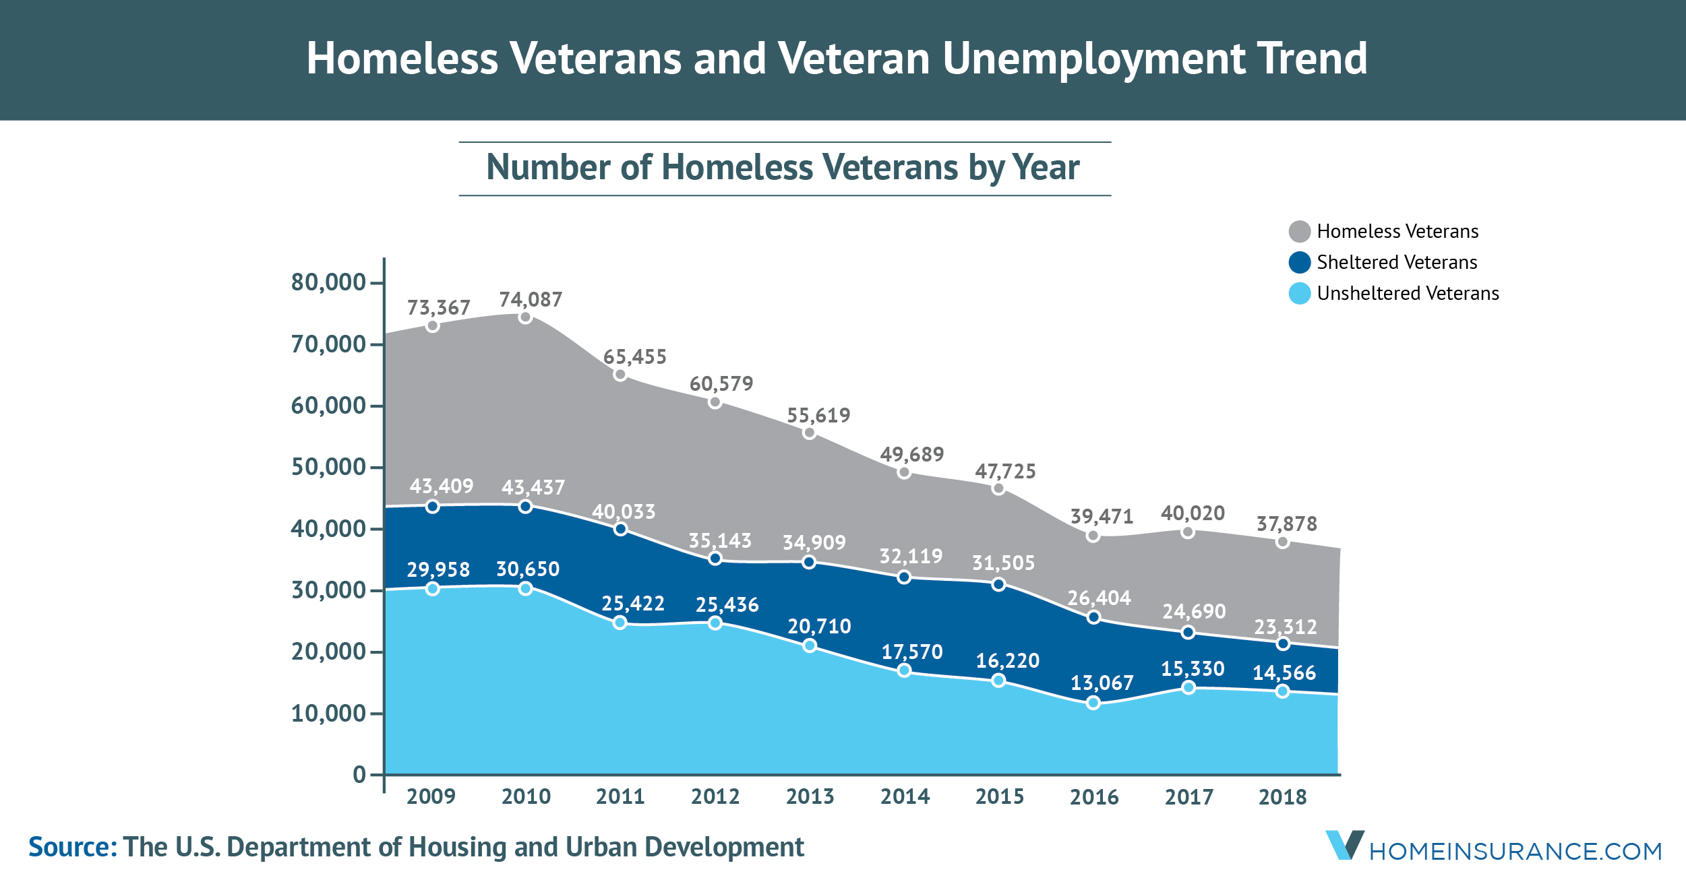
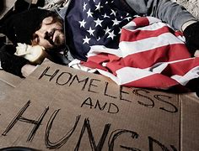
Shrinking the Problem Of Homeless Veterans
Chandler Howard
Faculty Sponsor: Professor Shelley Grant
Jacksonville University, Jacksonville, FL, USA
Significance
Discussion
Combating veteran homelessness is important because these are people who have served and sacrificed for their country, but many of them are having a hard time finding a safe place to live. Research shows that there is no one way to end veteran homelessness, but a mix of different approaches can make a big difference.
Veteran Homelessness. (n.d.). Tunnel to Towers Foundation.
Addressing the homeless veterans in our country requires access to high quality mental health care, increasing availability of affordable housing and streamlined access to veteran assistance programs It is a major problem in the United States, with there being an estimated 40,056 homeless veterans in our country according to the Department of Housing and Urban Development.
(HUD 2021)
Introduction
The United States is a country that prides itself on taking care of men and women who serve in the military. However there is homeless veterans all over the U.S, on a single night in 2024 the U.S. Department of Housing and Urban Development estimated that there was 35,574 veterans who were experiencing homelessness.(HUD 2023) Overall addressing the homeless crisis among veterans in the United States requires access to high quality mental health care, increased availability of affordable housing and streamlined access to veteran assistance programs. People can also help out with buying meals and things of that nature for them.
Findings
Conclusions
In 2023, veteran homelessness increased by 7.4% (Diaz, 2023).
About 33,000 veterans experience homelessness on any given night (U.S. Department of Housing and Urban Development, 2024).
Veterans make up about 6% of all homeless adults in America (Tani, 2025).
Since 2010, veteran homelessness has decreased by about 50% due to government and community efforts (U.S. Department of Housing and Urban Development, 2024).
The VA's Housing First program provides housing without requiring sobriety or mental health treatment first, helping veterans stabilize quicker (Health Services Research & Development, 2024).
The VA has provided:
Over 40,000 permanent housing placements for homeless veterans in recent years
Addressing the homeless veterans in our country requires access to high quality mental health care, increasing availability of affordable housing and streamlined access to veteran assistance programs.
References
Diaz, M. (2023, December 15). Veteran homelessness increased by 7.4% in 2023. VA News; U.S. Department of Veterans Affairs.
Tani, Therese. Homeless Veterans in America 2025. “Percentage of Homeless Veterans in America 2025.” EBSCOhost.
U.S. Department of Housing and Urban Development. (2024). HUD.gov / U.S. Department of Housing and Urban Development (HUD).
Veterans’ Homelessness: Trends and Solutions. Health Services Research & Development, U.S. Department of Veterans Affairs, Summer 2024.
Objectives
Discuss the urgent problem of homelessness and the necessity of a urgent response.
Inspire people to support groups that offer homeless veterans homes and food.
Recognize the sacrifices homeless veterans made and get rid of the stigma associated with them.

