Slide 1
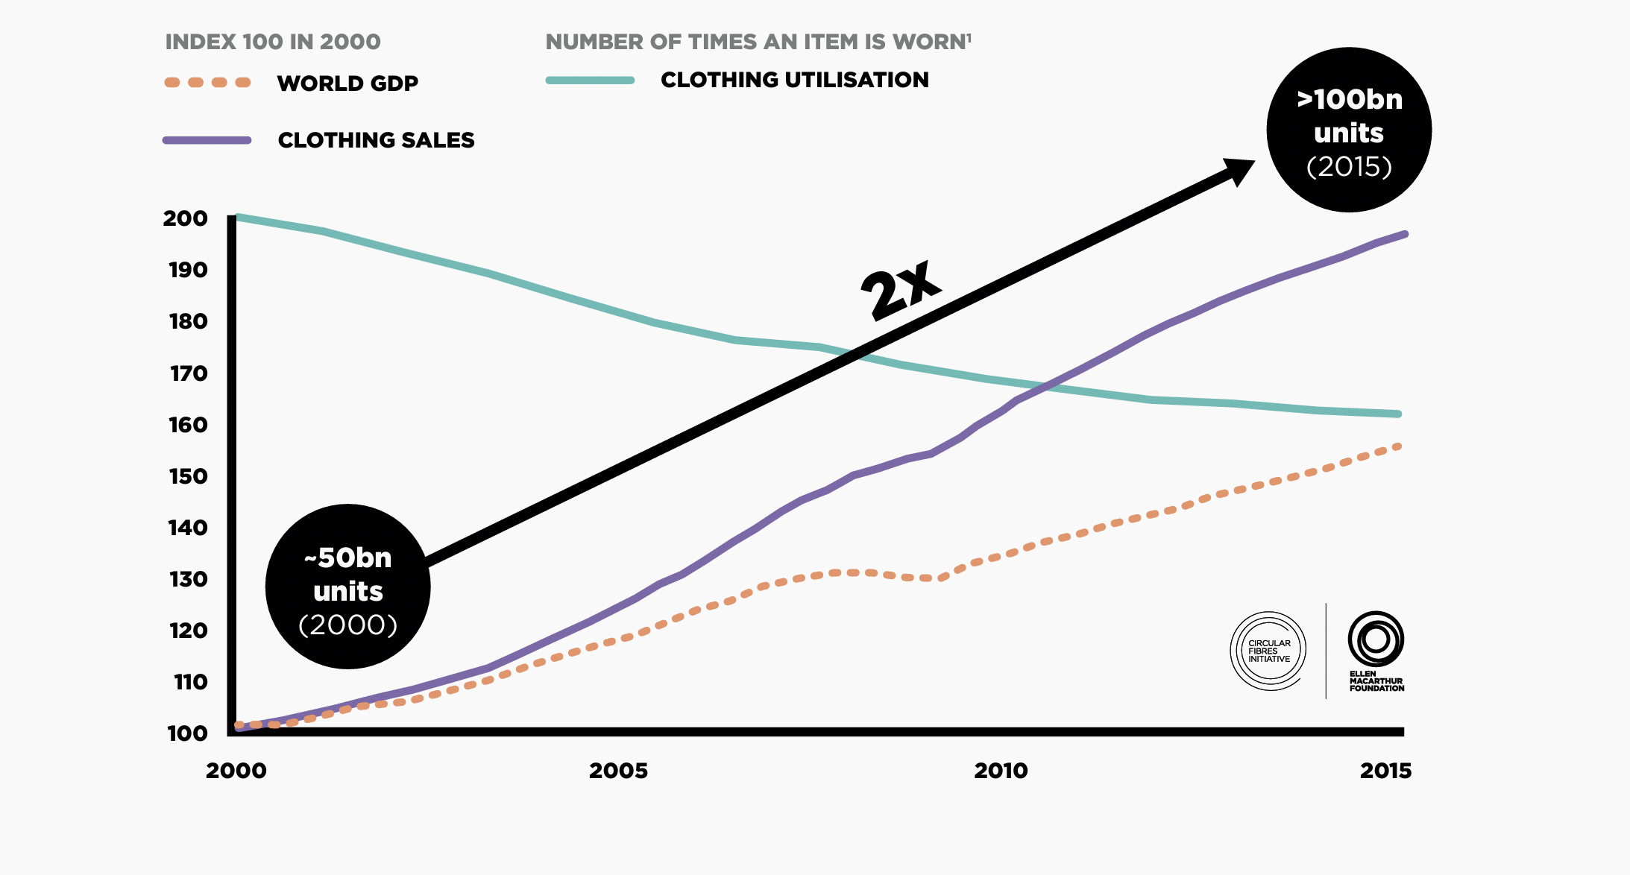
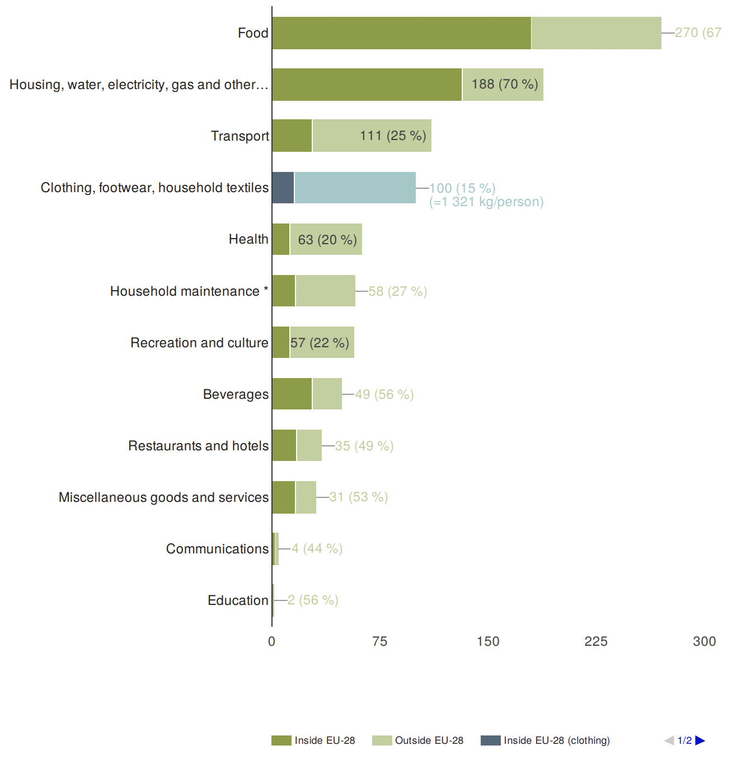
Fast Fashion is Out of Fashion
Morgan Madetzke
Faculty Sponsor: Professor Shelley Grant
Jacksonville University, Jacksonville, FL, USA
Significance
Environmental Impact
Fashion Influencers
The devastating impacts of fast fashion on the environment are the result of consumption culture, trusted marketing by social media fashion influencers, and intentional obsolescence. Research suggests that although consumers may be educated on sustainability, they’re unlikely to alter their purchasing habits to be ethical. This paper advocates for federal regulation of the fashion industry in the United States, hoping to potentially slow the pace at which the fast fashion industry damages the planet.
The most damage is done through water textile waste and water pollution. Americans generate 25 billion pounds of textile waste every year. Annually, the fashion industry is responsible for the pollution and consumption of 79 trillion liters of water and 35% of the microplastics, which pollute our oceans and take hundreds of years to break down. (Mohn, 2024). In 2015 alone, the fashion industry consumed 93 billion cubic meters of water and 1,715 million tons of carbon dioxide were emitted. These figures are projected to increase to 118 billion cubic meters of water and 2,791 million tons of carbon dioxide by 2030. (EMF, 2017; GFA and BCG, 2017, as cited in Olivar Aponte., et al 2024).
From 2000 to 2015, the number of garments made by the fashion industry skyrocketed from 50 billion to 100 billion. Fashion influencers have contributed to this growth by promoting fast fashion via their widely followed social media accounts. Consumers are drawn to make impulsive buys from fast fashion companies that these fashion influencers advertise due to the more personal form of marketing, the convenience of online shopping, and discounts that further lower the price of the fast fashion items consumers
are already considering for purchase (Moch, 2024).
Introduction
Fast fashion is a sector of the fashion industry that rapidly produces poor-quality clothing for affordable prices to keep pace with ever-changing trends. According to the European Environmental Agency, fashion is the fourth highest consumer of primary resources, following food, housing, and transportation.
(EEA, 2019, as cited
in Olivar Aponte., et
al 2024).
A new textiles economy: Redesigning Fashion’s Future. A New Textiles Economy: Redesigning Fashion’s Future. (n.d.). https://www.ellenmacarthurfoundation.org/a-new-textiles-economy
Conclusions
Romeo, J. (2023, November fashion graveyard: Earth science article for students: Scholastic Science World magazine. Scholastic Science World. https://scienceworld.scholastic.com/issues/2023-24/112023/fast-fashion graveyard.html?language=english#1070L 20). Fast
Consumer purchasing habits seem to be unaffected by their knowledge of, or lack there of, about sustainability. Therefore, it would be of the most benefit to the environment if we were to utilize fashion influencers to promote eco friendly brands, give fashion tips that are sustainable, and could potentially make slow fashion trend, which could influence the fashion industry to be more sustainable. Furthermore, by reforming policies enforce stricter regulations regarding the pollution that the fast fashion industry causes in countries and unions such at the United States, we could potentially cut back on the damage being done to our environment.
Textiles in Europe’s circular n.d.). economy. European Environment Agency’s home page. ( https://www.eea.europa.eu/en/analysis/publications/textiles-in-europes-circular-economy
Intentional Obsolescence
Consumption Culture
Notable fast fashion brands including H&M, Zara, and Mango release new clothing collections every 3-5 weeks, encouraging consumption and creating more textile waste. (Esposti et al., 2024). The clothing itself is bad quality. Although it doesn’t cost as much money to make cheap garments, the real reason brands opt for poor-quality pieces is that it’s not made to last more than a few uses. So even if a customer isn’t shopping for the sake of following trends, then they’d likely have to come back to get some sort of replacement for their unwearable clothes. Instead of going elsewhere to purchase better quality clothing consumers return to fast fashion brands, because the clothing is both stylish and affordable (Moch, 2024).
Fast fashion brands release a limited number of pieces per collection, which encourages customers to make impulse buys, which are pushed by fashion influencers. A poll showed that 75% of women wore a dress 2-3 times before getting rid of it because they didn’t consider them to be fashionable anymore (Akurat, 2019), as cited in Moch, 2024). People have also associated the excitement of buying new clothes with happiness and feel the need to continue to purchase fast fashion to nourish those wants. Oftentimes, consumers find themselves with full closets and nowhere to store clothing that they don’t need as a result (Moch, 2024).
References
Bernard, A. L. (2023). The Hidden Costs Behind Cheap Clothing: Addressing Fast Fashion’s Environmental and Humanitarian Impact. Vanderbilt Journal of Entertainment & Technology Law, 25(3), 541–567.
Esposti, P. D., Mortara, A., & Roberti, G. (2024). Unsustainable Fashion: SHEIN and the Fast Fashion Consumption Model. Italian Sociological Review, 14(3), 929–951. https://doi.org/10.13136/isr.v14i3.822
Moch Zihad Islami, Yoga Aditya Leite, Dian Aris Munandar, Yuana Novita Sari, & Sonjoruri Budiani Trisakti. (2024). Ethical Challenge of Fashion Influencers Endorsement: Analysing Communication and Consumption Culture. JKG (Jurnal Komunikasi Global), 13(1), 1–25. https://doi.org/10.24815/jkg.v13i1.37492
Mohn, E. (2024). Fast Fashion. Salem Press Encyclopedia. https://research.ebsco.com/c/ty7tpe/viewer/html/f37embnlnn

