Slide 1
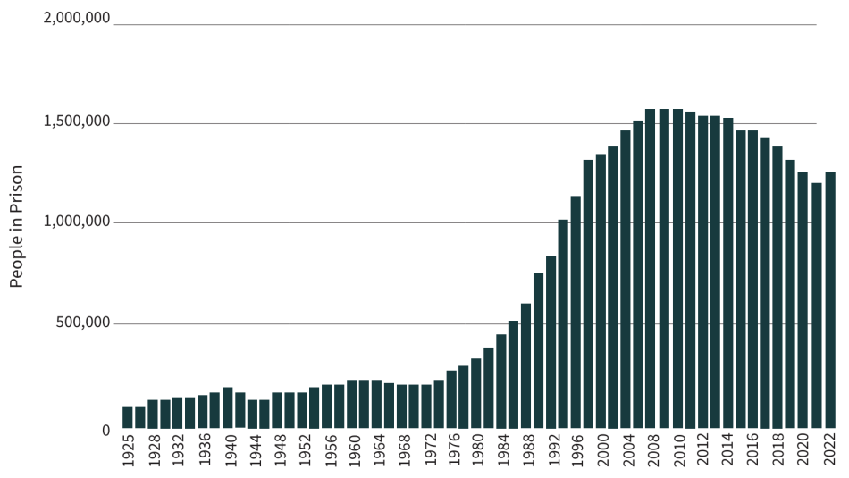
Breaking Barriers: Reintegration and Rehabilitation for Inmates
Kadence Thigpen
Jacksonville University, Jacksonville, FL, USA
Faculty Advisor: Professor Shelley Grant
Social Significance
Mass incarceration and reincarceration are serious problems in the United States, yet individuals housed within jails and prisons are not receiving the needed resources to successfully reintegrate back into society. Approximately 1.8 million individuals are incarcerated in the United States, with over 5 million under supervision by the correctional system. Nearly 469,000 people enter prisons each year, and roughly two-thirds of released individuals are rearrested within three years of release.(Prison Policy, 2025).
Reincarceration and recidivism are considered wicked problems in the United States due to the complex, deeply rooted systemic issues within the country. While some rehabilitation options are available, they are very limited within the prison system. Expanding these programs is the first major change needed to make a meaningful difference.
History
Limitations
The United States has consistently had one of the highest incarceration rates in the world, with significant fluctuations over the decades. By the late 1990s and early 2000s, the U.S. prison population had skyrocketed, peaking around 2008 with over 1.5 million people incarcerated (Sentencing Project, 2024). In recent years, however, there has been a gradual decline in incarceration rates due to criminal justice reforms, changes in drug policies, and efforts to reduce sentencing for nonviolent offenses.
Nevertheless, the need for change remains critical. Despite some progress, incarceration rates have worsened over the years, and if the corrections and criminal justice systems continue following the same practices, this ongoing issue will persist without improvement.
There is hope for change within the system; however, significant limitations hinder progress and ultimately prevent meaningful reform. While adding rehabilitation efforts to all prisons and jails may seem like a straightforward solution, multiple barriers stand in the way, including:
Insufficient funding and overcrowding
Lack of staff training and a focus on punishment over rehabilitation
Lack of community care and support
Prison culture
Discrimination, stigma, and limited focus on reentry
Trauma, hopelessness, and high recidivism rates
Figure 1 (Sentencing Project,2024)
Conclusion
Prison rehabilitation is often overlooked yet essential for reducing recidivism. Equipping inmates with the right skills and supports allow them to reintegrate back into society successfully.
Findings
3 in 5 people (63%) with a history of mental illness do not receive mental health treatment while incarcerated (NAMI, 2024).
Drug offenses account for the incarceration of over 360,000 people, and police make almost a million drug arrests each year (Prison Policy, 2025).
Two-thirds of people in local jails have substance use disorders, yet only a tiny fraction of all jails provide medication-assisted treatment for opioid use disorder—the gold standard for care (Prison Policy, 2025).
Between 2000 and 2018, the number of people who died of intoxication while in jail increased by almost 400%; typically, these individuals died within just one day of admission (Prison Policy, 2025).
Jails often place people with mental health issues in solitary confinement, provide limited access to counseling, and leave them unmonitored due to staffing shortages—leading to suicides, which are the leading cause of death in local jails (Prison Policy, 2025).
Incarceration-based rehabilitation programs are, on average, 43% more likely to reduce recidivism compared to inmates who did not receive rehabilitation (University of Louisville, 2013).
References
Objectives
Christopher Uggen, R. L., Nazgol Ghandnoosh, Ph. D. on S. 8, & Nicole D. Porter on August 11, 2022. (2024, May 31). Mass incarceration trends. The Sentencing Project. https://www.sentencingproject.org/reports/mass-incarceration-trends/
Dixon, S. A. (2013, August). The new paradigm of rehabilitation : A meta-analysis of the effectiveness of incarceration-based rehabilitation in regards to recidivism reduction. ThinkIR: The University of Louisville’s Institutional Repository. https://ir.library.louisville.edu/etd/357/
Mental health treatment while incarcerated. NAMI. (2024, May 6). https://www.nami.org/advocacy/policy-priorities/improving-health/mental-health-treatment-while-incarcerated/#:~:text=About%20three%20in%20five%20people,in%20state%20and%20federal%20prisons.
Wagner, W. S. and P. (n.d.). Mass incarceration: The whole PIE 2025. Prison Policy Initiative. https://www.prisonpolicy.org/reports/pie2025.html#:~:text=Drug%20offenses%20still%20account%20for,which%20lead%20to%20prison%20sentences.
Provide effective rehabilitation programs for incarcerated individuals that address mental health, substance abuse, and vocational skills is essential to reducing recidivism and the likelihood of reincarceration.
Expand rehabilitation programs to support reentry into society would make a tremendous difference within the correctional system.
Address the barriers to success that incarcerated individuals face, not only while in a jail or prison, but also upon release.

