Slide 1



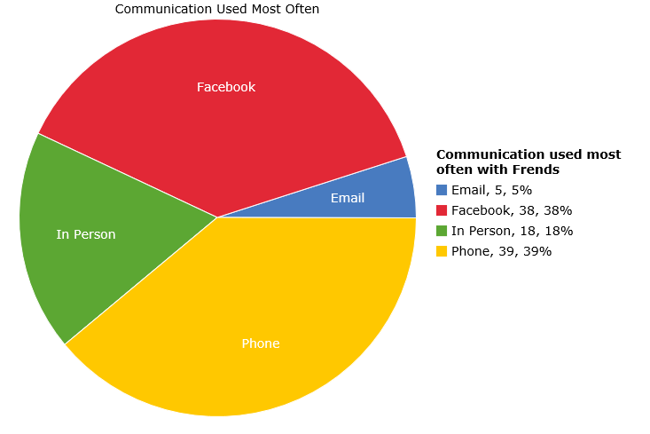
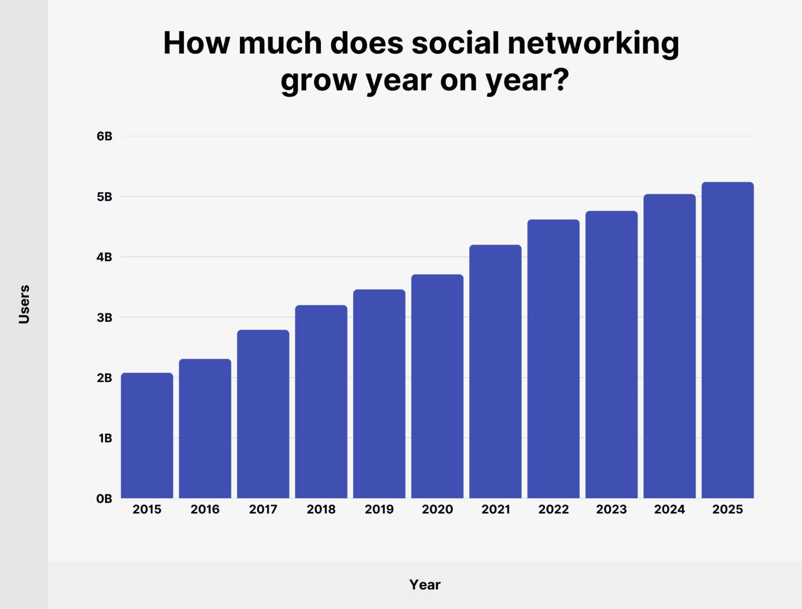
Reclaiming College Students Health in a
Socially Connected World
Emily Turner
Faculty Sponsor: Professor Shelley Grant
Jacksonville University, Jacksonville, FL, USA
Significance
Objectives
Is doom scrolling leading people to their doom? Big social media platforms spends billions of dollars on research and development to keep users on their webpages. This has a negative effect on college students with brains that are not fully developed, harming college students' mental health, physical health, and social skills.
Excessive social media usage among college students causes major issues to arise in many aspects of their life:
Social Skills
Mental Health
Physical Health
Social Skills
Introduction
An unhealthy relationship with social media causes a student's social skills, such as communication and attention span, to decrease (Brooks, 2015). Society normalizes technology use in daily life, creating the idea that communicating through the screen is more efficient. As reflected in figure 2, students grew accustomed to communicating via social media rather than face-to-face conversations (Raut Vishranti & Patil Prafulla, 2016).
There are many issues in this world with no real solution, but one that not only is continuing to rise but also does not have enough acknowledgement is the spike of technology usage, specifically social media and the negative costs of it on a person. Within the college community, college students mental and physical health, as well as social skills have downward spiraled due to excessive usage of social media (Malak et al., 2022). Anxiety and depression levels have increased, communication skills have vanished, and physical wellbeing is being sacrificed (Malak et al., 2022). Not only college students but as people, we have become connective yet isolated and dependent of our digital devices.
Figure 2- (StatCrunch, 2014)
Mental Health
Conclusions - Future Work
Excessive use of social media causes an individual to experience higher levels of anxiety, depression, and stress. This is from the constant watch of others lives and experiencing the aching want of having more or the fear of missing out, seen in many college students. Also, we have seen a chain link of being stressed, causing the student to experience anxiety, which depending on the intensity, causes depression (Malak Et Al., 2022).
While social media is beneficial for some communication, extended use has many negative effects to one’s body and self. It is important to stay aware, spread awareness, and take on the challenge to overcome this digital dependency, while improving mentally, physically, and socially.
References
Physical Health
Brooks, S. (2015). Does personal social media usage affect efficiency and well-being? Computers in Human Behavior, 46, 26–37.
Dean, B. (2025, February 10). Social Network Usage & Growth Statistics. Backlinko.
Malak, M. Z., Shuhaiber, A. H., Al-amer, R. M., Abuadas, M. H., & Aburoomi, R. J. (2022). Correlation between psychological factors, academic performance and social media addiction: Model-based testing. Behaviour & Information Technology, 41(8), 1583–1595.
Raut, Vishranti, & Patil, Prafulla. (2016). Use of social media in education: Positive andnegative impact on the students.
Shankar, S. B., Rani, S. L., & Brundha, M. P. (2020). Comparison study of factors associated with smartphone addiction among college students. Drug Invention Today, 14(7), 1165–1168.
StatCrunch. (2014, February 16). Methods of Communication Used Most Often. Statcrunch.com; Pearson.
The physical wellbeing of students has started to decline. There has been many accounts of back pain, neck pain, posture issues, headaches, and sleep deprivation caused by the constant use of social media within college students (Raut Vishranti & Patil Prafulla, 2016). The long hours being on it causes headaches and sleep deprivation, as well as the position someone's neck and back is, causing the posture issues and neck aches (Shankar et al., 2020).
Figure 1- (Dean, 2025)

