Slide 1
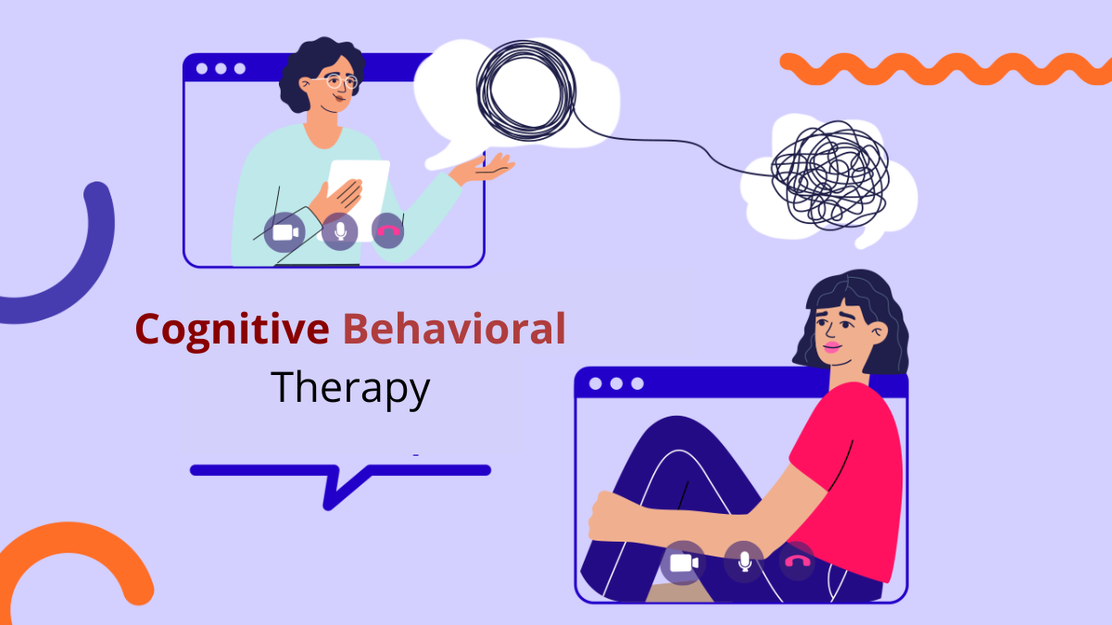
Effective Natural Treatments for Mental Health Disorders
Abney Marcelle Fricks
Faculty Sponsor: Professor Shelley Grant, Maddie Eash
Jacksonville University, Psychology Department
High-quality evidence consistently supports the efficacy of exercise as both an adjunct to existing treatments, such as psychotherapy and pharmacotherapy, and as an independent intervention for a variety of mental health conditions. Research has demonstrated that exercise is effective in managing a range of mental disorders, including major depressive disorder, anxiety disorders, post-traumatic stress disorder (PTSD), and schizophrenia (Kate, Andrew, Gideon, Richard, 2024). Exercise serves as a natural and potent anti-anxiety treatment, alleviating tension and stress, promoting both physical and mental health, and enhancing overall well-being through the endogenous release of endorphins. Additionally, exercise has been shown to improve cognitive function and increase resilience to stress, further contributing to its therapeutic potential in managing mental health disorders.
In the United States, there is a growing trend of over-prescription of medications, particularly Selective Serotonin Reuptake Inhibitors (SSRIs), for mental health conditions. While these pharmacological treatments are commonly prescribed, they are often associated with significant adverse effects that can negatively impact health. Research indicates that individuals using antidepressants experience a 14% increased risk of heart attacks and strokes, along with a 33% higher risk of mortality (Petersen, 2019). The over-reliance on pharmaceuticals frequently contributes to issues such as overmedication, dependency, and exacerbated long-term health outcomes. Despite the proven efficacy of non-pharmacological treatments, including psychotherapy, these approaches remain underutilized within clinical practice.
Exercise Therapy
Significance
Cognitive Behavioral Treatment Therapy
Pg 1. Michelle Welling
Cognitive Behavioral Therapy (CBT) is a form of psychotherapy designed to assist individuals in identifying and modifying negative or maladaptive thoughts, emotions, and behaviors, with a focus on the present moment and the development of effective coping strategies. The efficacy of CBT in preventing depression relapse has been well-documented, with studies indicating that it reduces the risk of relapse by a factor of eight and decreases the likelihood of future recurrent episodes of depression (Ioannou, Prodromou, Apostolidou, Kallergis, 2023). The analysis included 13 studies, all of which focused on patients diagnosed with depression. CBT was administered through various modalities, including in-home sessions, individual therapy, and group therapy. Participants who underwent CBT demonstrated significant improvement, with recovery rates ranging from 70% to 75%.
Pg. 1, Hillwill
Problem
Conclusions
Evidence indicates that antidepressants are frequently overprescribed, with 73% of healthcare visits resulting in the prescription of antidepressants to patients who have not been diagnosed with a psychiatric condition (Petersen, 2019).
An estimated 26% of American adults aged 18 and older, or approximately one in four individuals, experience a diagnosable mental disorder in any given year (Petersen, 2019).
The side effects of Selective Serotonin Reuptake Inhibitors (SSRIs) are varied and include symptoms such as vomiting, sweating, headaches, insomnia, dry mouth, tremors, sexual dysfunction, and potential changes in personality (Cascade, 2019).
Concerns surrounding the long-term use of SSRIs include the risk of dependency and the potential for a "crash" when discontinuing use. Additionally, SSRIs may interact with other medications, leading to potentially harmful effects (Harvard Medical, 2019).
There is accumulating evidence suggesting that prolonged use of the antidepressant Paxil may increase the risk of developing dementia (Osborn, 2024).
Compelling evidence shows that there are highly effective, scientifically- based methods to dramatically reduce mental health disorders without the need of prescription medications.
These treatments effectively alleviate the symptoms of mental health disorders while eliminating the risk of harmful side effects associated with traditional medications.
Initially, animal-assisted therapy was considered an innovative and unconventional approach. However, due to its demonstrable benefits, it has since been recognized as a complementary treatment modality (Oliver, Peter, Fricke, 2025). This study explores the relationship between animal-assisted therapy and mental health through a bibliometric analysis. The findings suggest that animal-assisted therapy not only improves psychological well-being but also mitigates physical stress responses, such as reducing heart rate and lowering blood pressure, thereby contributing to overall better health. In line with Horvath and Symonds' (1991) concept of a healthy therapeutic alliance, which is characterized by mutual affection, respect, trust, warmth, and acceptance, the presence of a therapy animal may foster a sense of security and acceptance—key elements that support an individual’s recovery process.
Pg 1. Husson University
Animal-Assisted Therapy
References
FORNEFELD, D. et al. The supporting role of dogs in the inpatient setting: a systematic review of he therapeutic effects of animal-assisted therapy with dogs for children and adolescents in an inpatient setting. European Child & Adolescent Psychiatry, [s. l.], v. 34, n. 1, p. 3–17, 2025. DOI 10.1007/s00787-
Ioannou, A., Prodromou, M., Andrea-Apostolidou, S., & Kallergis, G. (2023). Effectiveness of Cognitive Behavioral Therapy in patients with depression. Nosileftiki, 62(3), 31–42.
Kelly, K., Moloney, A., de Jong, G., & Lakeman, R. (2024). Healthcare Practitioners’ Perceptions of the Barriers to Prescribing or Promoting Exercise in the Treatment of People with Mental Illness: A Scoping Review. Health & Social Care in the Community, 2024, 1–20.
“Mental Health Disorder Statistics.” Johns Hopkins Medicine, 20 June 2024,
New Concerns Emerge about Long- Term Antidepressant ..., 2019, adaa.org/sites/default/files/New Concerns Emerge About Long-Term Antidepressant Use.pdf.
Sharma, S., & Dhanoa, S. K. (2022). Bibliographical Analysis on Animal Assisted Therapy and Mental Health. Journal of Algebraic Statistics, 13(2), 2910–2934.

