Slide 1
Punitive versus Rehabilitative Approaches to Juvenile Crime: Survey Research for the State Attorney’s Office, 4th Judicial Circuit
Presentation by: Dr. Ray Oldakowski, Professor Shelley Grant, Soraya Aidinejad, Sydney Hamrick, Kristin Haycock, and Kayla McGhee

Slide 2
Introduction
Uniform Crime Report
  Arrests of juveniles for all offenses decreased 3.4 percent in 2019 when compared with the 2018 number.
    In 2019, Juvenile offenders represent approximately 7% of all arrests in the United States.
The original intent of the juvenile justice system
  Work in the “best interests of the child” with a focus on rehabilitation
Purpose of our research
  To determine if Northeast Florida residents are more supportive of rehabilitative or punitive responses to juvenile crime.

Slide 3
History
History
  In the 1980s and 90s there was an increased fear of juvenile “superpredators”
  This increased the public’s opinion that the juvenile justice system was too lenient and that the way to prevent crime was through punitive measures
  Result was an increase in juvenile commitments and transfers into the adult criminal justice system

Slide 4
Juvenile Justice Policy and Dispositions
Court’s effectiveness in protecting the rights of juveniles in delinquency cases
  In re Gault – 1967 - the Supreme Court began to impose
  procedural due process requirements on juvenile court adjudication
  Roper v. Simmons – unconstitutional to impose the death penalty for a crime committed by a child under the age of 18 on the basis that juveniles have an underdeveloped sense of responsibility and that they are in less control over their environment and actions
  Graham v. Florida – Decisions by the Supreme Court of the United States holding that juvenile offenders cannot be sentenced to life imprisonment without parole for non-homicide offenses.
  Miller v. Alabama – the Court held that mandatory sentences of life without the possibility of parole are unconstitutional for juvenile offenders.
Brain development
  Childhood is usually seen as a period in which individuals have not yet fully developed self-control and their impulses tend to lead to misbehavior and acts of delinquency.
  There is a lack of agreement among scholars regarding the age at which psychosocial maturity and general cognitive capacity reach their maximum values, but it is closer to the mid 20’s.
The Age-Crime Curve
  Research findings agree that the prevalence of offending increases from late childhood into adolescence, peaks in late adolescence, and decreases subsequently into adulthood. This is generally known as the age-crime curve.

Slide 5
Perceptions of Juvenile Offenders
Today, juvenile offenders are either seen as young adults or as children which plays a role in the punitive or rehabilitative treatments they receive.
When we look at these juvenile offenders as young adults, we tend to punish them rather than rehabilitate them, but their brains are not working at the same capacity that an adult’s brain would be, so they are more prone to make negative choices and may not fully comprehend the consequences.
Many of the significant Supreme Court cases of the last 15 years regarding juveniles have been based on the increasing knowledge of the workings of the teenage brain.
How are juveniles seen by society?

Slide 6
Public Attitudes and Support for Juvenile Offenders
Rehabilitation and Non-Judicial Handling
Punitive Responses
Support for Rehabilitation
  Those with both high and low awareness of juvenile crimes tend to support rehabilitative handling of juvenile offenders rather than punitive
Non-judicial Handling of Juvenile Offenders
  Two major parts of non-judicial handling of juvenile offenders are diversion and civil citations
  Diversion is when the youth are still held accountable for their actions but there is an intervention that prevents them from going in the juvenile justice system
  Civil citations are a diversion method where the youth go to a diversion program and when they successfully complete it, they are able to go free without an arrest record
In years past, the public has feared juvenile crime under the belief that juvenile delinquency has been increasing.
Between 1992 and 1999, all but one state expanded legislation that made it easier for juveniles to be tried as adults.
Commitment and adult transfer of juveniles
  Two out of every three confined youth are held in the most restrictive facilities – in the juvenile justice system’s versions of jails and prisons, or in actual adult jails and prisons.
  4,535 confined youth - nearly 1 in 10 – are incarcerated in adult jails and prisons, where they face greater safety risks, and fewer age-appropriate services are available to them.

Slide 7
Research Questions
Are the residents of Duval, Clay, and Nassau Counties more supportive of programs designed to rehabilitate juvenile criminal offenders such as civil citations or diversion OR do they prefer programs designed to punish juvenile criminal offenders such as commitment programs?
Do their opinions vary significantly among different subgroups of the population including those based on age, race, education, and income?
Do their opinions vary significantly among the different geographic units in our study area such as counties or parts of Jacksonville?
Does any geographic variance in opinion correlate with geographic variance in crime rates?

Slide 8

Methodology: Survey Research
To answer our research questions we chose to use survey research
Survey research is a quantitative and qualitative research method used for collecting data from a group of respondents
When doing survey research, the use of large random samples is important because they provide the most accurate estimates of what is true in the population.

Slide 9
Creation Of The Survey
Each of the project team members submitted potential questions to use in the survey based on previous research about juvenile delinquency and public opinion about criminal justice.
Some of these questions were discarded, some were used verbatim, and others were modified to address our specific research needs.
The questionnaire was comprised of 23 questions total. Each of the group members typed up the questions into Qualtrics Research, a Survey Research and Analytics Application
Before sending out the survey to our project sample, we each asked colleagues and acquaintances to go review the questionnaire and notify us of any issues or problems. The final version of the questionnaire was updated based on these pretest responses.

Slide 10
Distribution of the Questionnaire
The questionnaire was administered via email.
We obtained a sample of approximately 30,000 residents of Duval, Clay, and Nassau counties proportional to the county’s population size.
Each of the Project team members were given a portion of the sample to recruit and manage. Potential respondents were contacted 3 times and asked to participate.

Slide 11
Data Analysis
After the results for this project is gathered, we will then download the data from Qualtrics and import it into SPSS for analysis.
We will then utilize the use of statistical analysis tools like ANOVA’S and Chi Squared to showcase if our survey results are significant.
Does the data support the questions we asked about the results or negate the questions?

Slide 12
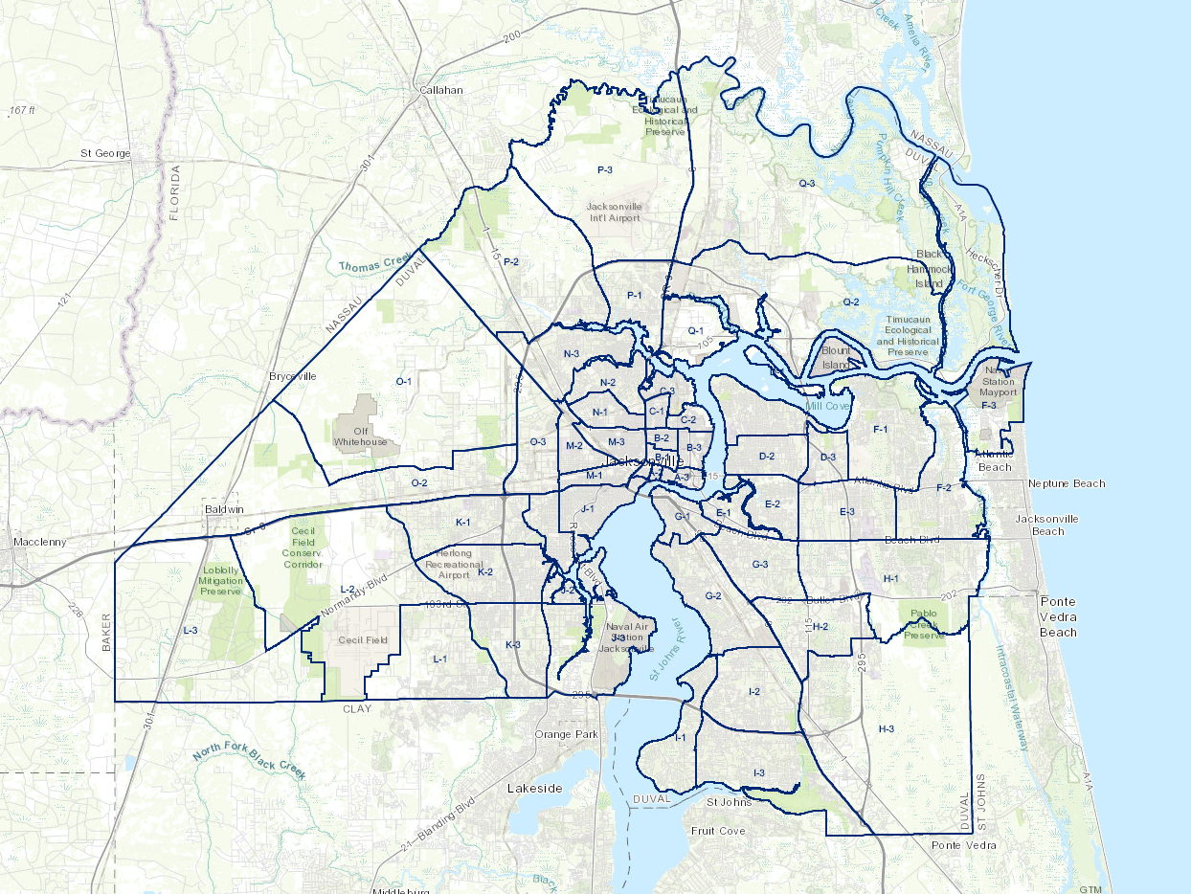
Geographic Information Systems (GIS)
We hope to determine the level of influence of mediating factors such as the socioeconomic and geographic characteristics of the respondents.
We will do this by integrating knowledge on juvenile crime with survey research and spatial analysis via Geographic Information Systems (GIS).
Duval County Patrol Zones Map
Image Source: https://www.jaxsheriff.org/Sheriff-s-Office/patrol-division.aspx

Slide 13

Geographic Information Systems (GIS)
We will also utilize GIS to see if there are any variances by county in Jacksonville, Florida.
Since Duval County is so large, we will have to analyze our data by crime zones.
We have asked people for their zip codes and their neighborhood within the survey.
Even though the zip codes may not correspond exactly with the crime zones, we can use this information in order to best correlate them with the given neighborhoods by respondents.

Slide 14
Preliminary Survey Results
Data collection November 2 – 14, 3 waves
Sample of 30,000 email addresses PPS, ~ 10% undeliverable
n = 366
Additional data collection first week of December, some targeting

Slide 15
Thinking about the criminal justice system in the United States as a whole, would you say it needs a complete overhaul, it needs major changes, it needs minor changes, or no changes need to be made?
A complete overhaul 13.6%
Major changes 37.1
Minor changes 42.7
No changes needed 6.5

Slide 16
Thinking about the criminal justice system here in the Jacksonville area as a whole, would you say it needs a complete overhaul, it needs major changes, it needs minor changes, or no changes need to be made?
A complete overhaul 12.7%
Major changes 34.2
Minor Changes 41.9
No changes needed 11.2

Slide 17
In general, do you think our criminal justice system in the Jacksonville area is better, worse, or about the same as criminal justice systems in other parts of the country?
Better than 29.2%
Worse than 14.1
About the same 56.7

Slide 18
Overall, how would you rate the State Attorney's Office (prosecutor) in the Jacksonville area? Is it excellent, good, fair, or poor?
Excellent 8.7%
Good 36.9
Fair 28.5
Poor 11.3
Don't know 14.5

Slide 19
In general, do you think the State Attorney's Office in the Jacksonville area deals fairly, too harshly, or too leniently with persons accused of a crime?
Fairly 45.0%
Too harshly 21.1
Too leniently 33.9

Slide 20
Which of the following three outcomes is most important to you?
Getting juvenile offenders rehabilitative treatment, counseling, and supervision, even if that means they spend no time in a juvenile corrections facility 31.4%
Making sure juvenile offenders receive a serious punishment even if that means they are sent to a juvenile corrections facility 15.7
Making sure that juveniles are less likely to commit another crime, regardless of whether they receive rehabilitative treatment or are sent to a juvenile corrections facility 52.8

Slide 21
For what kind of offenses do you think juvenile offenders should be sent to a juvenile corrections facility?
Only for violent felonies 25.6%
For any Felony violent or nonviolent 31.1
For any felony or misdemeanor, but not status offenses like skipping school or running away 39.7
For any violation regardless of type 2.9
Under no circumstances .6

Slide 22
For what kind of offenses do you think juvenile offenders should be sent to adult court?
Only for violent felonies 56.4%
For any Felony violent or nonviolent 24.4
For any felony or misdemeanor, but not status offenses like skipping school or running away 8.6
For any violation regardless of type .6
Under no circumstances 9.9

Slide 23
For what kind of offenses do you think juvenile offenders should receive a civil citation, that is, an alternative to arrest for juveniles who commit less serious crimes?
For misdemeanors 52.7%
For misdemeanors and nonviolent felonies 36.9
Under no circumstances 10.4

Slide 24
For what kind of offenses do you think juvenile offenders should receive diversion, that is, a programmatic option that prevents juveniles from entering the juvenile court system for less serious crimes?
For misdemeanors 44.7%
For misdemeanors and nonviolent felonies 45.1
Under no circumstances 10.2

Slide 25
Have you ever voted in an election for State Attorney?
Yes 94.0%
No 6.0
How important is the treatment of juveniles by the criminal justice system when selecting a candidate to vote for in an election for State Attorney?
Very Important 50.7%
Somewhat Important 42.0
Not important at all 7.3

Slide 26
References
Ainsworth, J. (1996). The Court's Effectiveness in Protecting the Rights of Juveniles in Delinquency Cases. The Future of Children,6(3), 64-74. doi:10.2307/1602594
Sawyer, W. (n.d.). Youth Confinement: The Whole Pie 2019. Retrieved November 17, 2020, from https://www.prisonpolicy.org/reports/youth2019.html
Sheffer, J. (1995). Serious and Habitual Juvenile Offender Statutes: Reconciling Punishment and Rehabilitation Within the Juvenile Justice System. Vanderbilt Law Review, 48(2), 480-512.

