Slide 1

25Live Pro User Manual
2019
Debbie Guy
University Scheduler/Conference Coordinator
904.256.7048
dguy@ju.edu

Slide 2
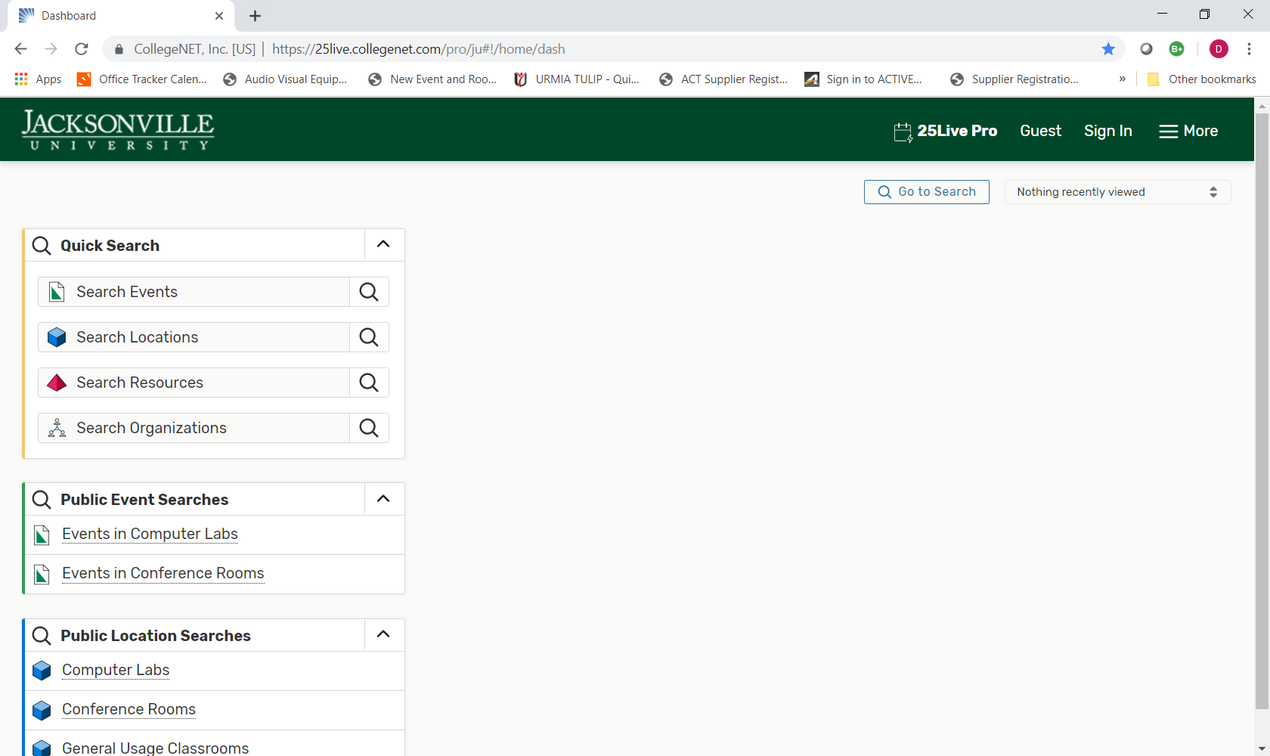
Signing into 25Live Pro
Google Chrome and Safari (for OS S and IOS users) are the recommended browsers for accessing 25Live Pro.
Users are strongly discouraged from using Internet Explorer and Mozilla Firefox.
Log in using your user ID and password.

Slide 3
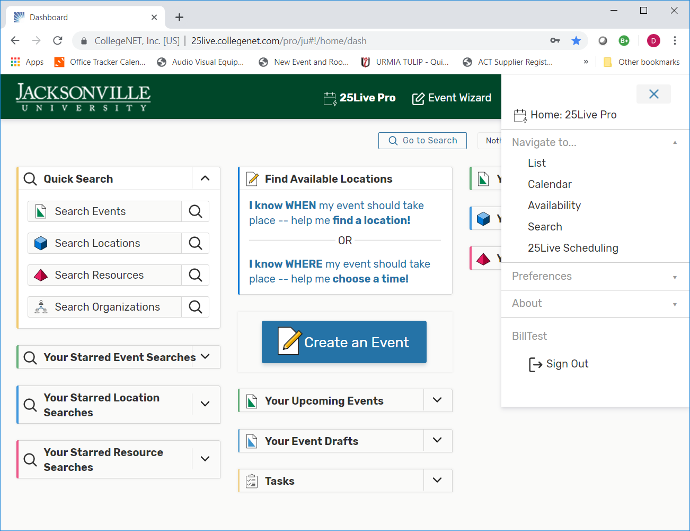
Accessing the Home Dashboard
These links will take you to your Home Dashboard, which functions the same as 25Live Classic it just looks a little different.

Slide 4
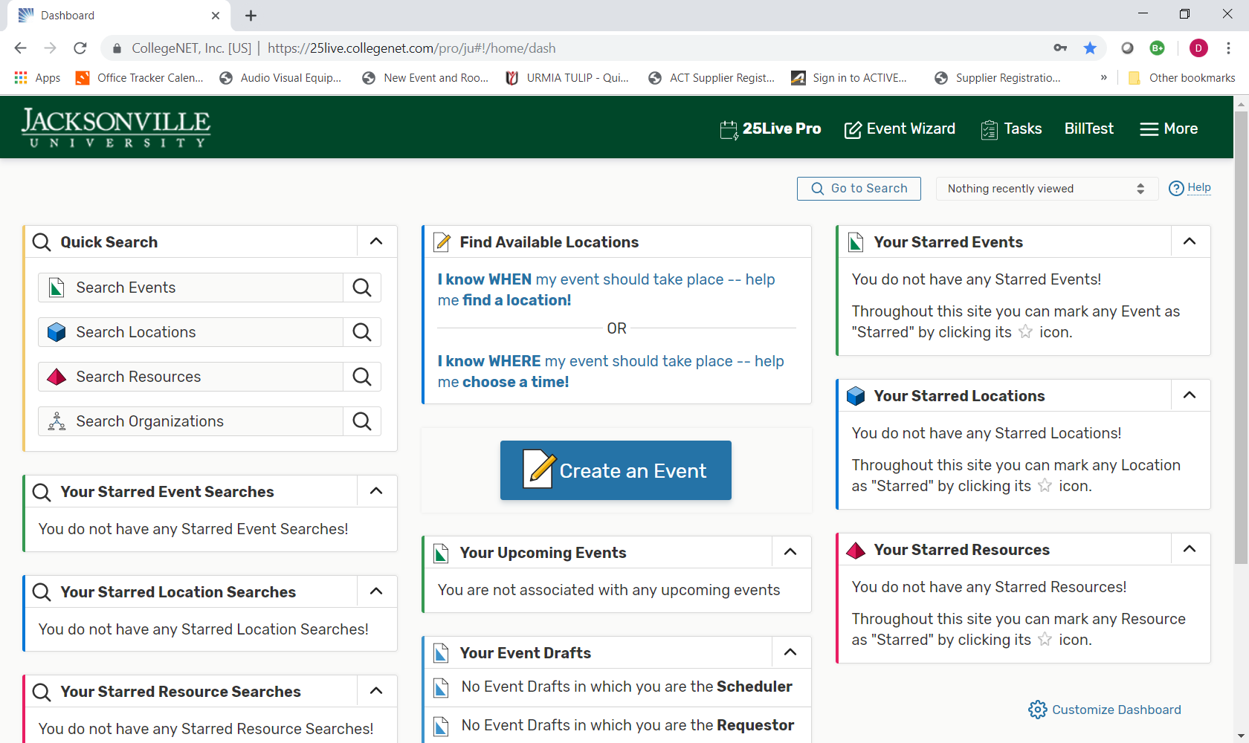
Customize your Dashboard your way
Dashboard

Slide 5
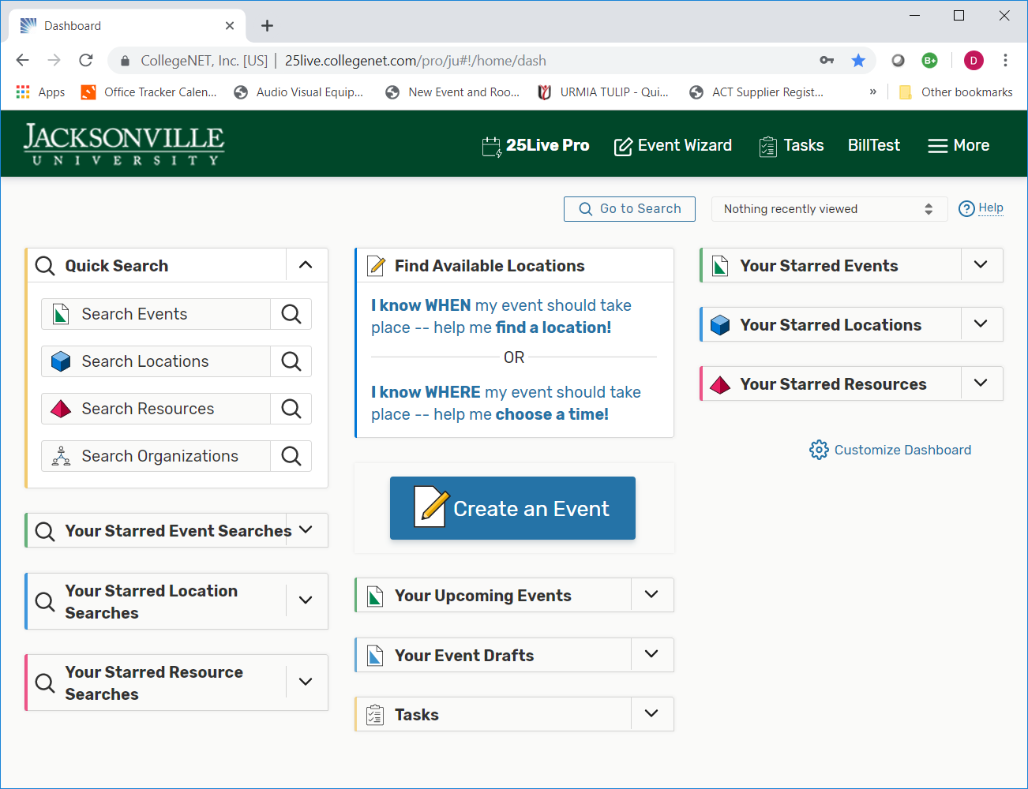
I know when my event should take place – help me find a location. or
I know where my event should take place – help me choose a time.
Finding an available Location

Slide 6
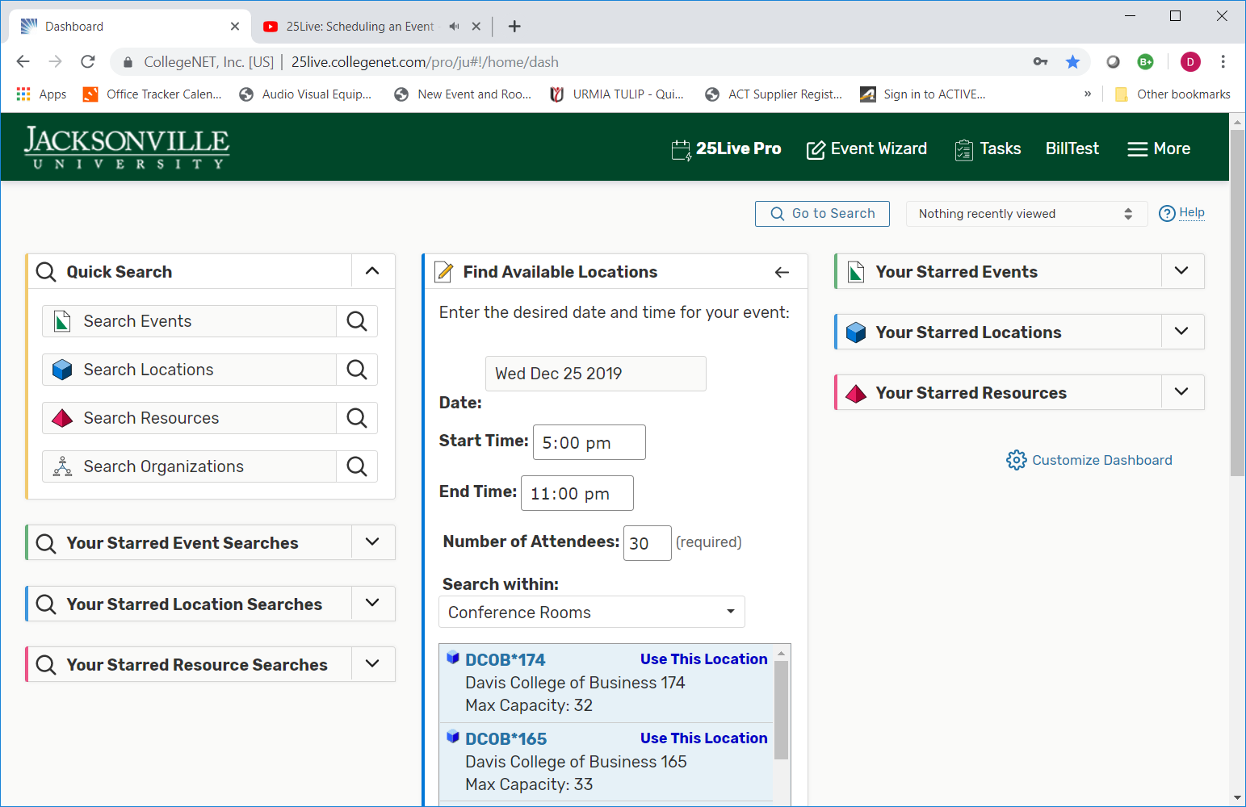
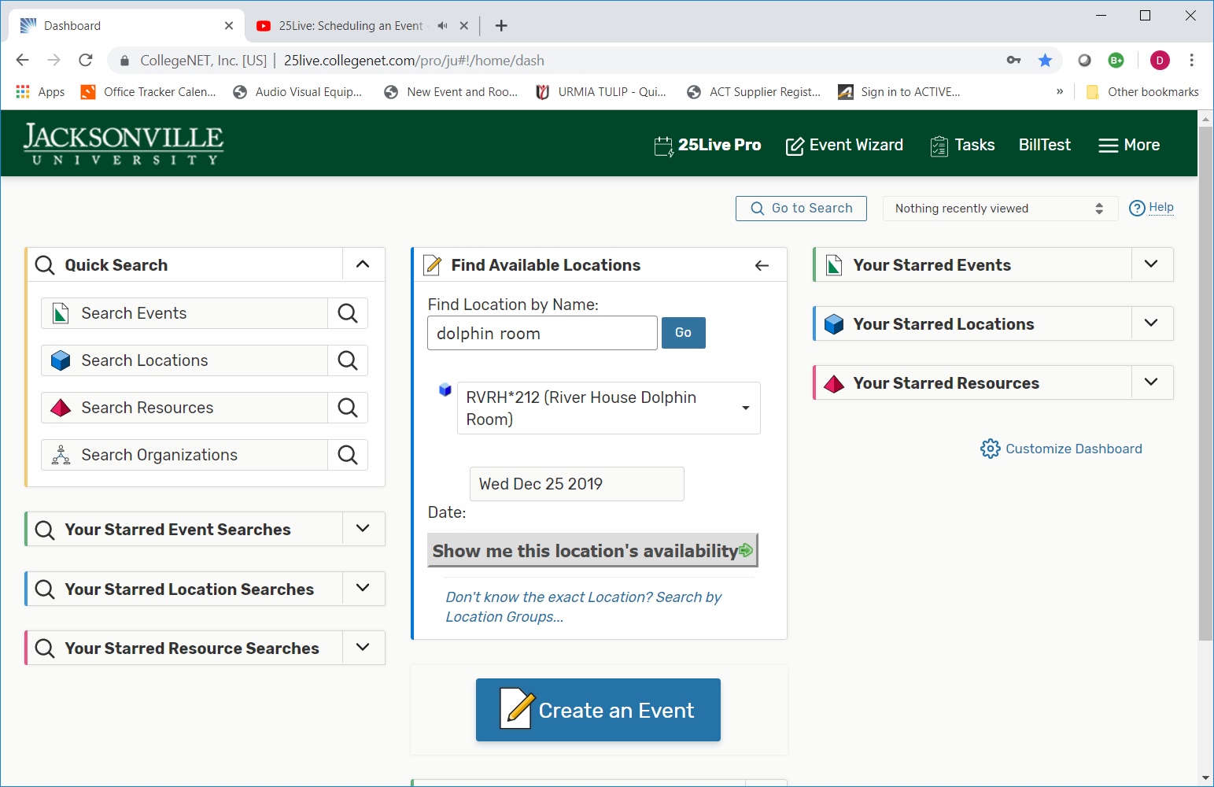
Find available locations, date, time, attendees, search.
I know my location, find availability, choose location, date.

Slide 7
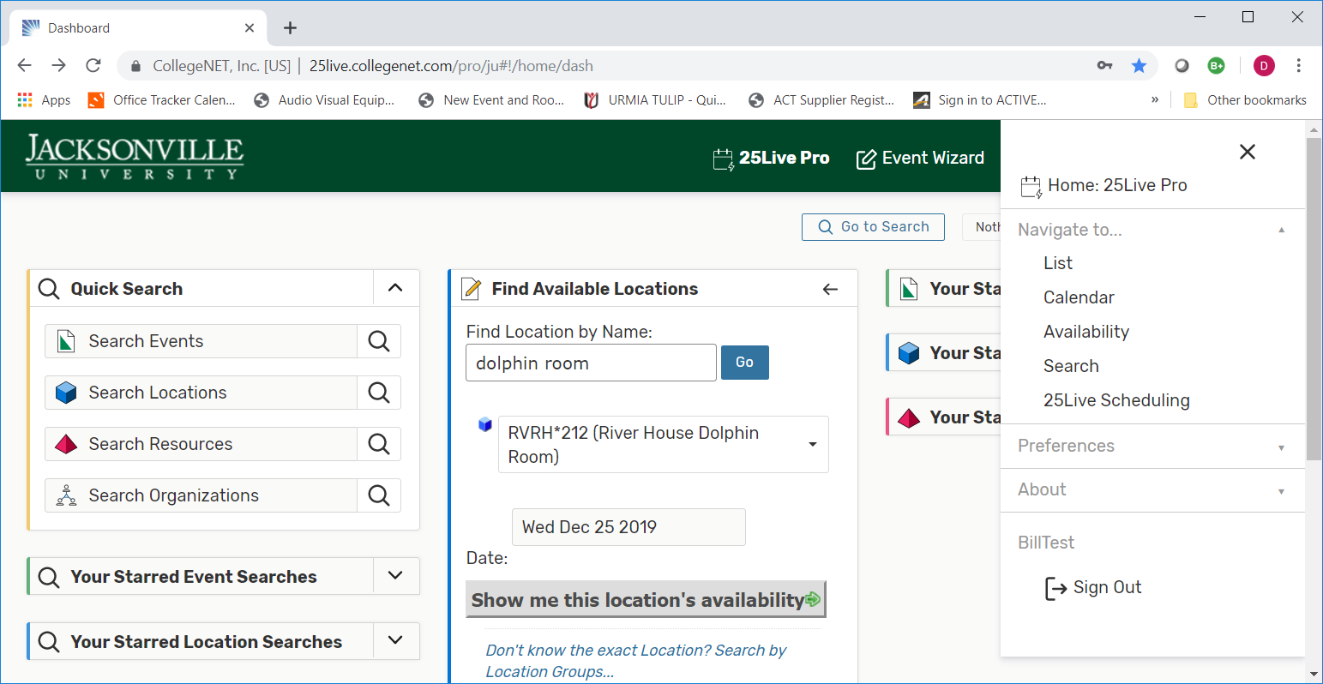
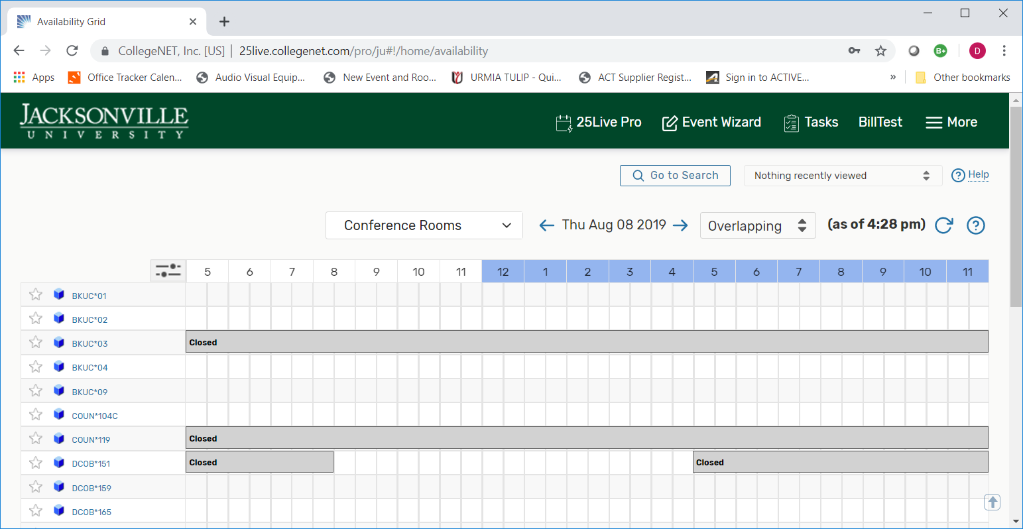
Another option to finding an available room
Under More select Availability
Select appropriate date
Select classrooms, conference rooms, Athletic locations, etc.
Scroll down to look for a room that has an open time.

Slide 8
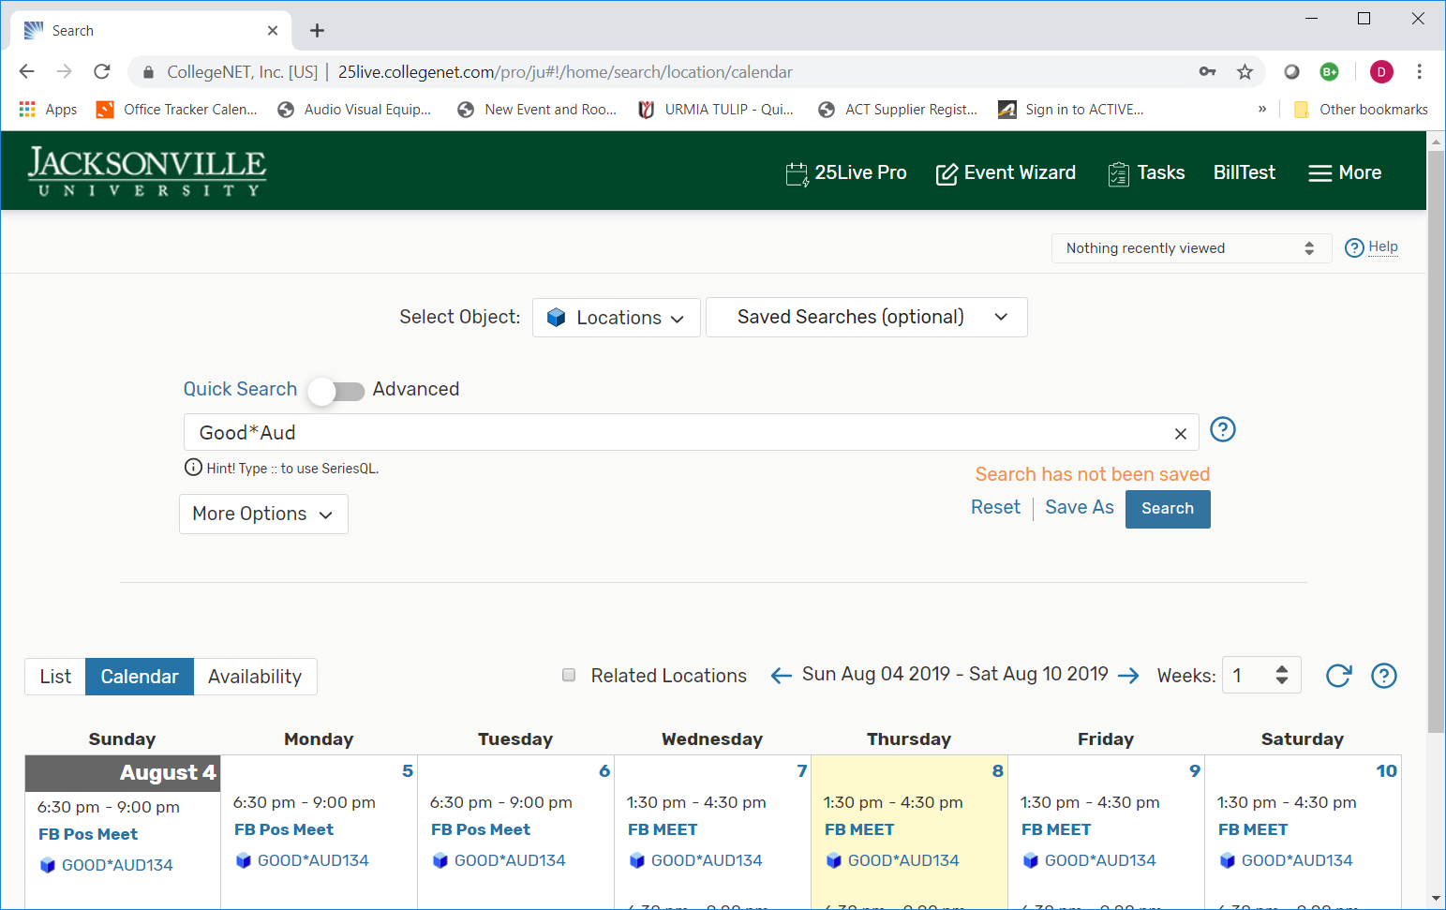
Looking for a specific room for available days/times
Under More select: Search
Select Object: select locations > enter the room
View available days/times for a specific room.
Select List/Calendar/or Availability
Select Calendar
Calendar shows scheduled events/classes
View – Select Day/Week or Month
Select more options to expand your search

Slide 9
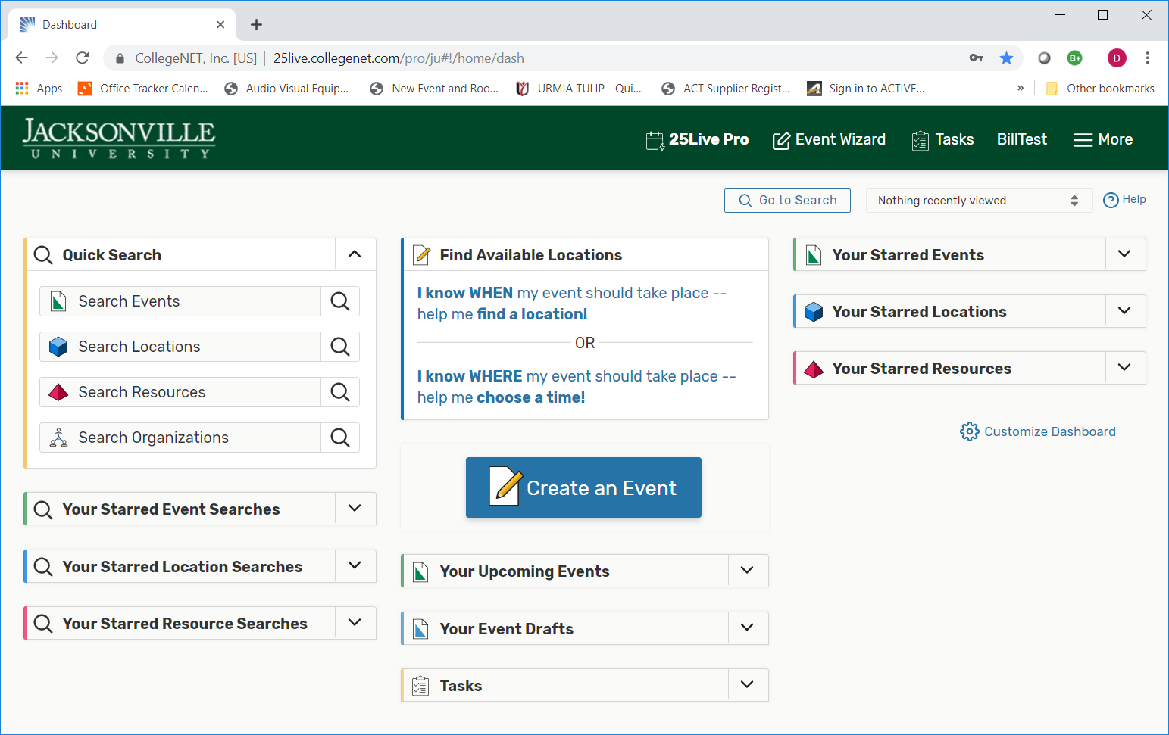
Create an Event
Click on “Create and Event”

Slide 10
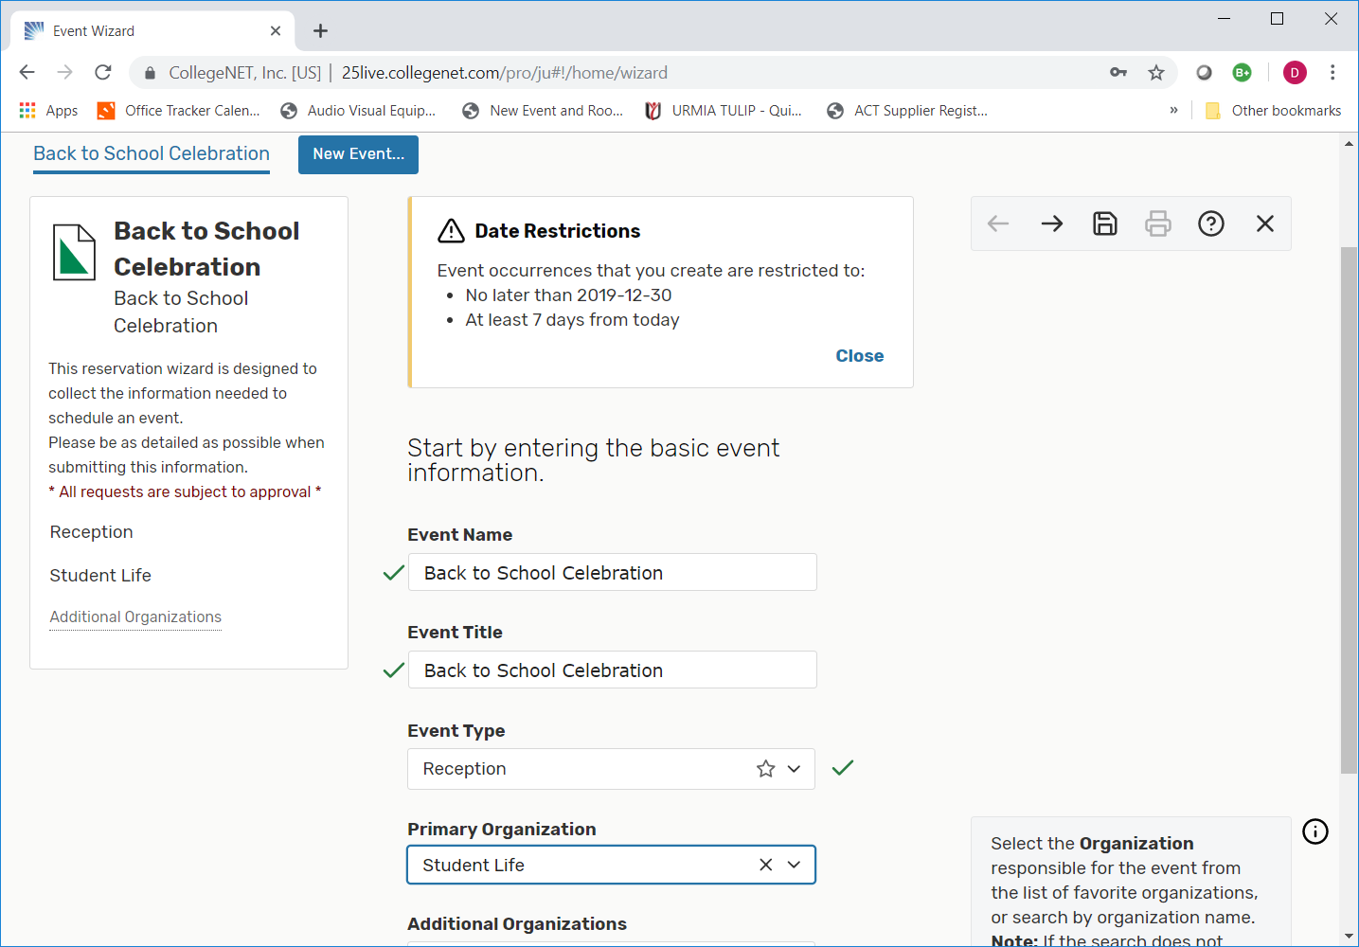
Creating an Event
From here, its very similar as it was before, but will change over the next month.
Fill in all the required fields

Slide 11
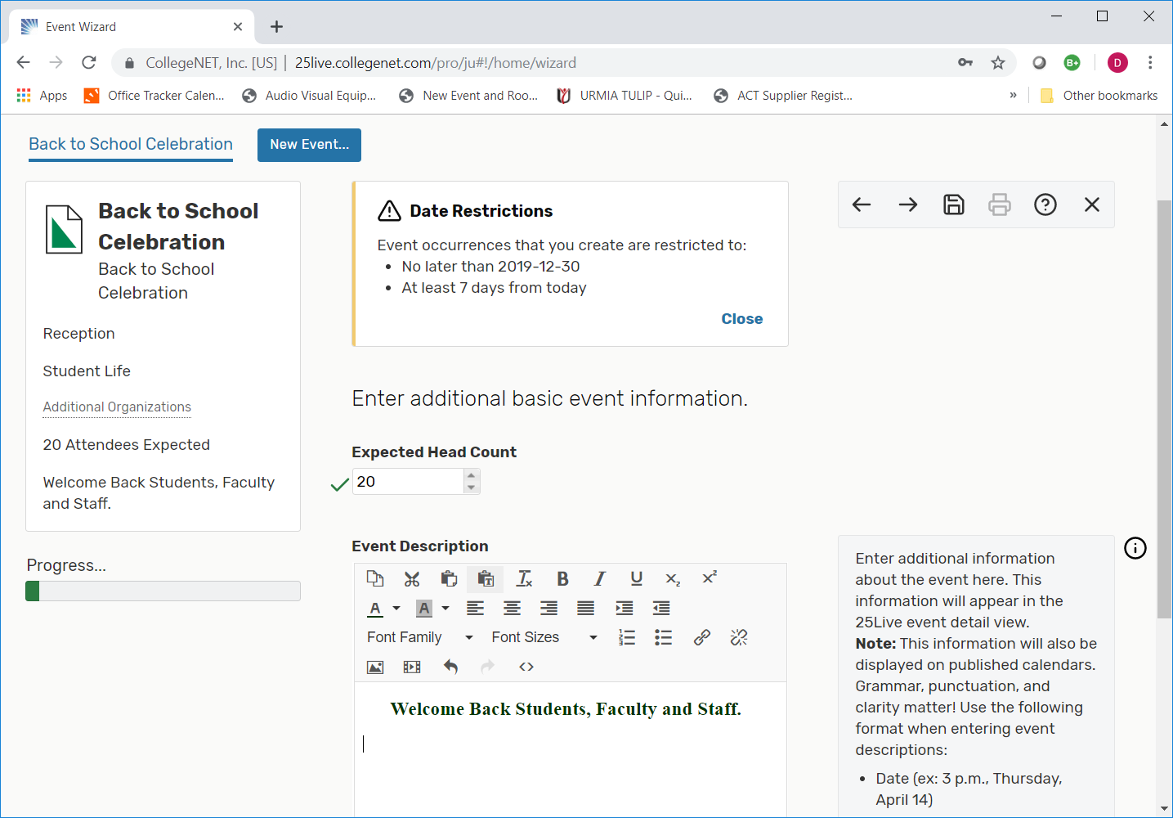
Expected Head Count – Most important when planning an event.
Event Description – There are so many choices to add to the description of this event.
Expected Head Count is a must for planning a successful event.
The Description is optional but helpful for approval.
This description fully explains what you want published to the Events Calendar.
Do not repeat the name, or date of the event in description.

Slide 12
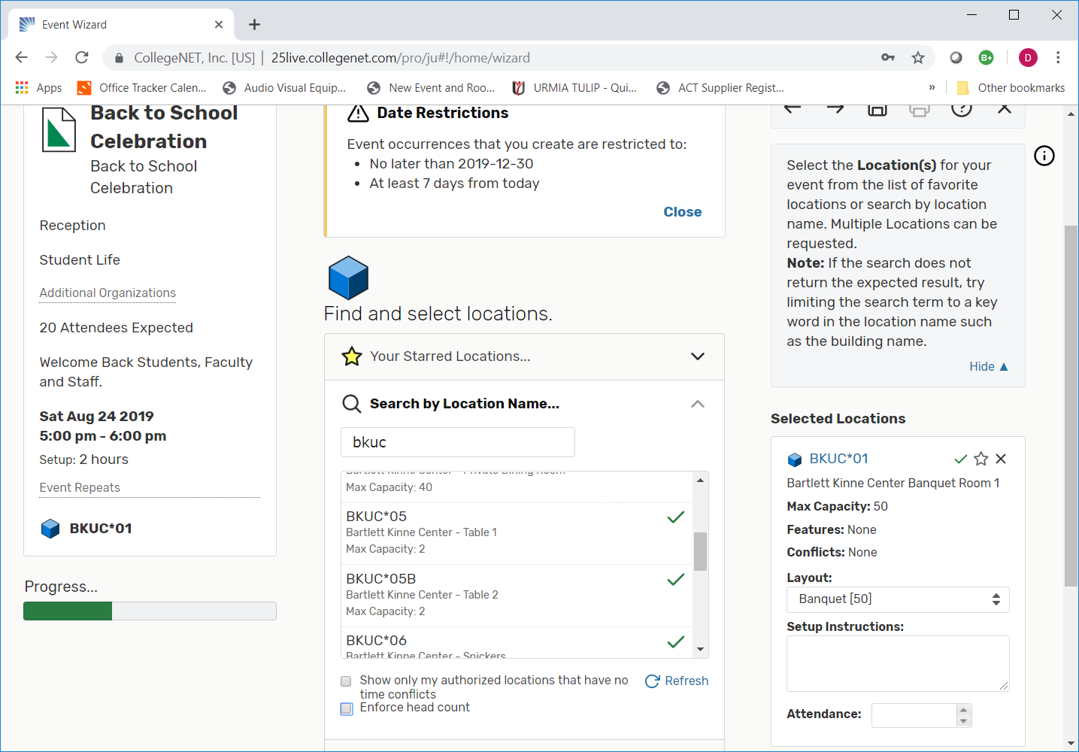
Keep Going…
Does this event have more than one Occurrence? For multiple days and does not span midnight select “Yes”
Does this event have multiple dates with different /locations and times for each date? Available in the near future.
Click on any date to add it to the Occurrence List
Select the X to the right of the date to cancel.
Find and select the location. Search by location name and then enter the room number.
Starred Items
Users can designate any event type, organization, location, resource or contact as a Starred Item by clicking on the hollow star icon.
When clicked, the Icon will turn yellow and be saved as a started item in the user’s 25Live Pro account
Selecting the Starred Item will allow user’s to speed up the scheduling process if they routinely request the same items often for events.

Slide 13
Coming Soon
New Categories added for a more successful event.
Display on Campus Web Viewer
Display in Specific College/Athletic/Student Calendar
Publish to Calendar
Do not Display on Web
Externally (JU Sponsored)
External Events
Proof of Insurance
Account number to be charged for expenses for external events
Hot Event (Important Event – 25Live calls it Hot Event)
Large Event (100 People or More)
Open to the Public
Registration?
Will this event be ticketed
Cultural Event
Will persons under the age of 18 be in attendance
a. If yes, numbers of minors attending.
Will there be catering served at this event
Will alcohol be served at this event
Request the President’s attendance
a. If yes, what is the President’s role at the event
Will official visitors be invited?
a. What is the Official Visitors name?
Renovation
Parking
Sorority/Fraternity/Organization Meeting
Floor plans for all larger locations to choose from.
Special Event Packets
And so much more….

Slide 14
Did you know
25Live Pro will prevent users from submitting requests less than seven (7) days prior to their desired event start date.
Users can expect to receive a confirmation 4 – 5 business days after submitting their 25Live Pro requests.
Student Organization will be denied from booking Special Events if requests are submitted within 20 days of their event date.
For more information visit www.ju.edu and click on Event Scheduling beginning September 1, 2019.

